Slide 1

Image Processing
By Girish Lande

Slide 2
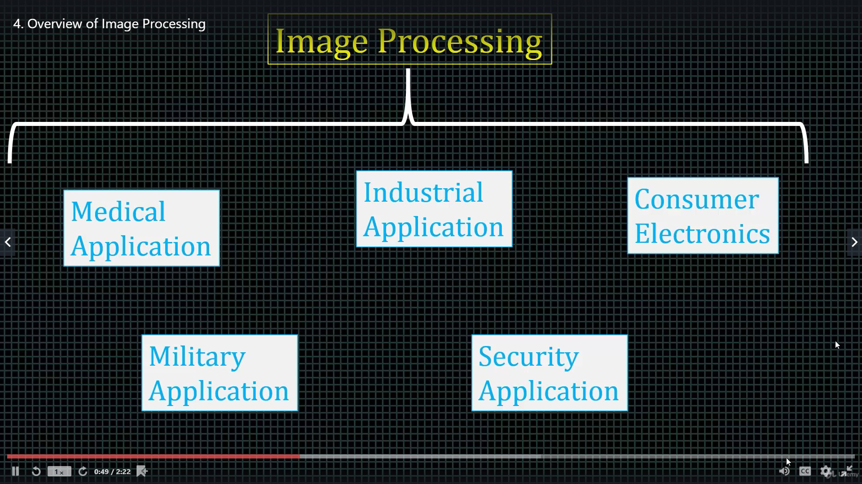
Header

Slide 3
Digital Image
An image is defined as a two-dimensional function,F(x,y), where x and y are spatial coordinates, and the amplitude of F at any pair of coordinates (x,y) is called the intensity of that image at that point. When x,y, and amplitude values of F are finite, we call it a digital image. In other words, an image can be defined by a two-dimensional array specifically arranged in rows and columns.
Digital Image is composed of a finite number of elements, each of which elements have a particular value at a particular location.These elements are referred to as picture elements,image elements,and pixels.A Pixel is most widely used to denote the elements of a Digital Image.

Slide 4
Types of image
BINARY IMAGE– The binary image as its name suggests, contain only two pixel elements i.e 0 & 1,where 0 refers to black and 1 refers to white. This image is also known as Monochrome.
BLACK AND WHITE IMAGE– The image which consist of only black and white color is called BLACK AND WHITE IMAGE.
8 bit COLOR FORMAT– It is the most famous image format.It has 256 different shades of colors in it and commonly known as Grayscale Image. In this format, 0 stands for Black, and 255 stands for white, and 127 stands for gray.
16 bit COLOR FORMAT– It is a color image format. It has 65,536 different colors in it.It is also known as High Color Format. In this format the distribution of color is not as same as Grayscale image.
A 16 bit format is actually divided into three further formats which are Red, Green and Blue. That famous RGB format.

Slide 5
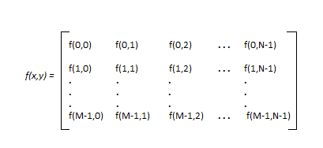
Image as Matrix
As we know, images are represented in rows and columns we have the following syntax in which images are represented:
The right side of this equation is digital image by defition. Every element of this matrix is called image element , picture element , or pixel.

Slide 6
Phases of Image processing
1.ACQUISITION– It could be as simple as being given an image which is in digital form. The main work involves:
a) Scaling
b) Color conversion(RGB to Gray or vice-versa)
2.IMAGE ENHANCEMENT– It is amongst the simplest and most appealing in areas of Image Processing it is also used to extract some hidden details from an image and is subjective.
3.IMAGE RESTORATION– It also deals with appealing of an image but it is objective(Restoration is based on mathematical or probabilistic model or image degradation).
4.COLOR IMAGE PROCESSING– It deals with pseudocolor and full color image processing color models are applicable to digital image processing.

Slide 7
Phases of Image processing
5.WAVELETS AND MULTI-RESOLUTION PROCESSING– It is foundation of representing images in various degrees.
6.IMAGE COMPRESSION-It involves in developing some functions to perform this operation. It mainly deals with image size or resolution.
7.MORPHOLOGICAL PROCESSING-It deals with tools for extracting image components that are useful in the representation & description of shape.
8.SEGMENTATION PROCEDURE-It includes partitioning an image into its constituent parts or objects. Autonomous segmentation is the most difficult task in Image Processing.
9.REPRESENTATION & DESCRIPTION-It follows output of segmentation stage, choosing a representation is only the part of solution for transforming raw data into processed data.
10.OBJECT DETECTION AND RECOGNITION-It is a process that assigns a label to an object based on its descriptor.

Slide 8
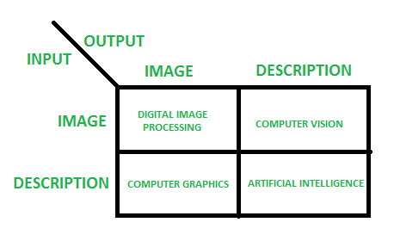
Fields
if input is an image and we get out image as a output, then it is termed as Digital Image Processing.
if input is an image and we get some kind of information or description as a output, then it is termed as Computer Vision.
if input is some description or code and we get image as an output, then it is termed as Computer Graphics.
if input is description or some keywords or some code and we get description or some keywords as a output, then it is termed as Artificial Intelligence

Slide 9
Histogram
Histogram Equalisation in C | Image Processing
A histogram of a digital image represents intensity distribution by plotting bar graph with X-axis as pixel intensity value and Y-axis as the frequency of its occurrence.
Histogram Equalisation is a technique to adjust contrast levels and expand the intensity range in a digital image. Thus, it enhances the image which makes information extraction and further image processing easier.

Slide 10
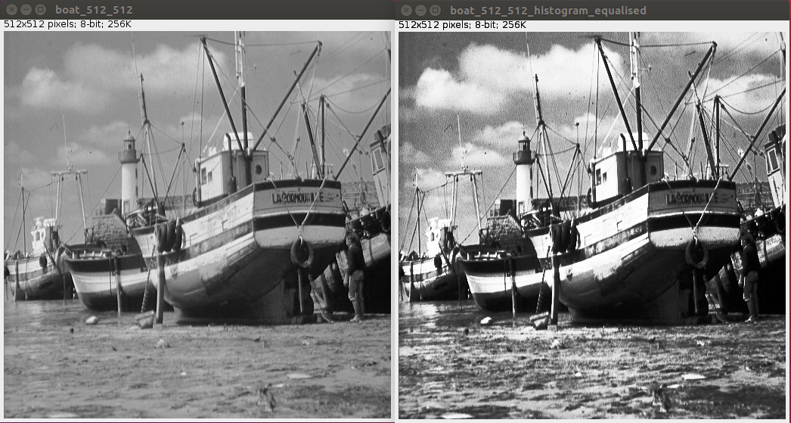
Histogram Equalisation

Slide 11
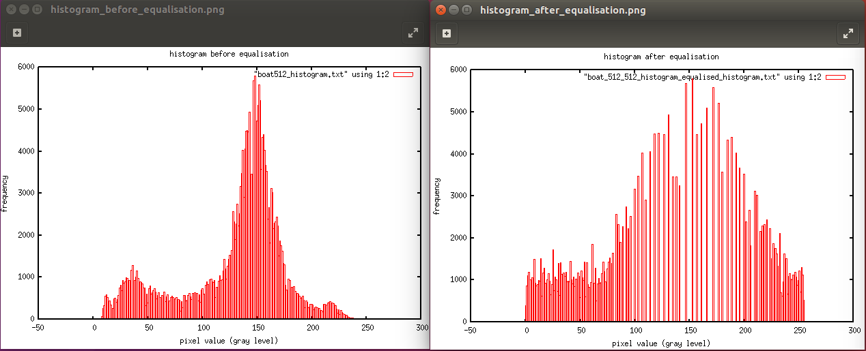
Transformation of Histogram

Slide 12
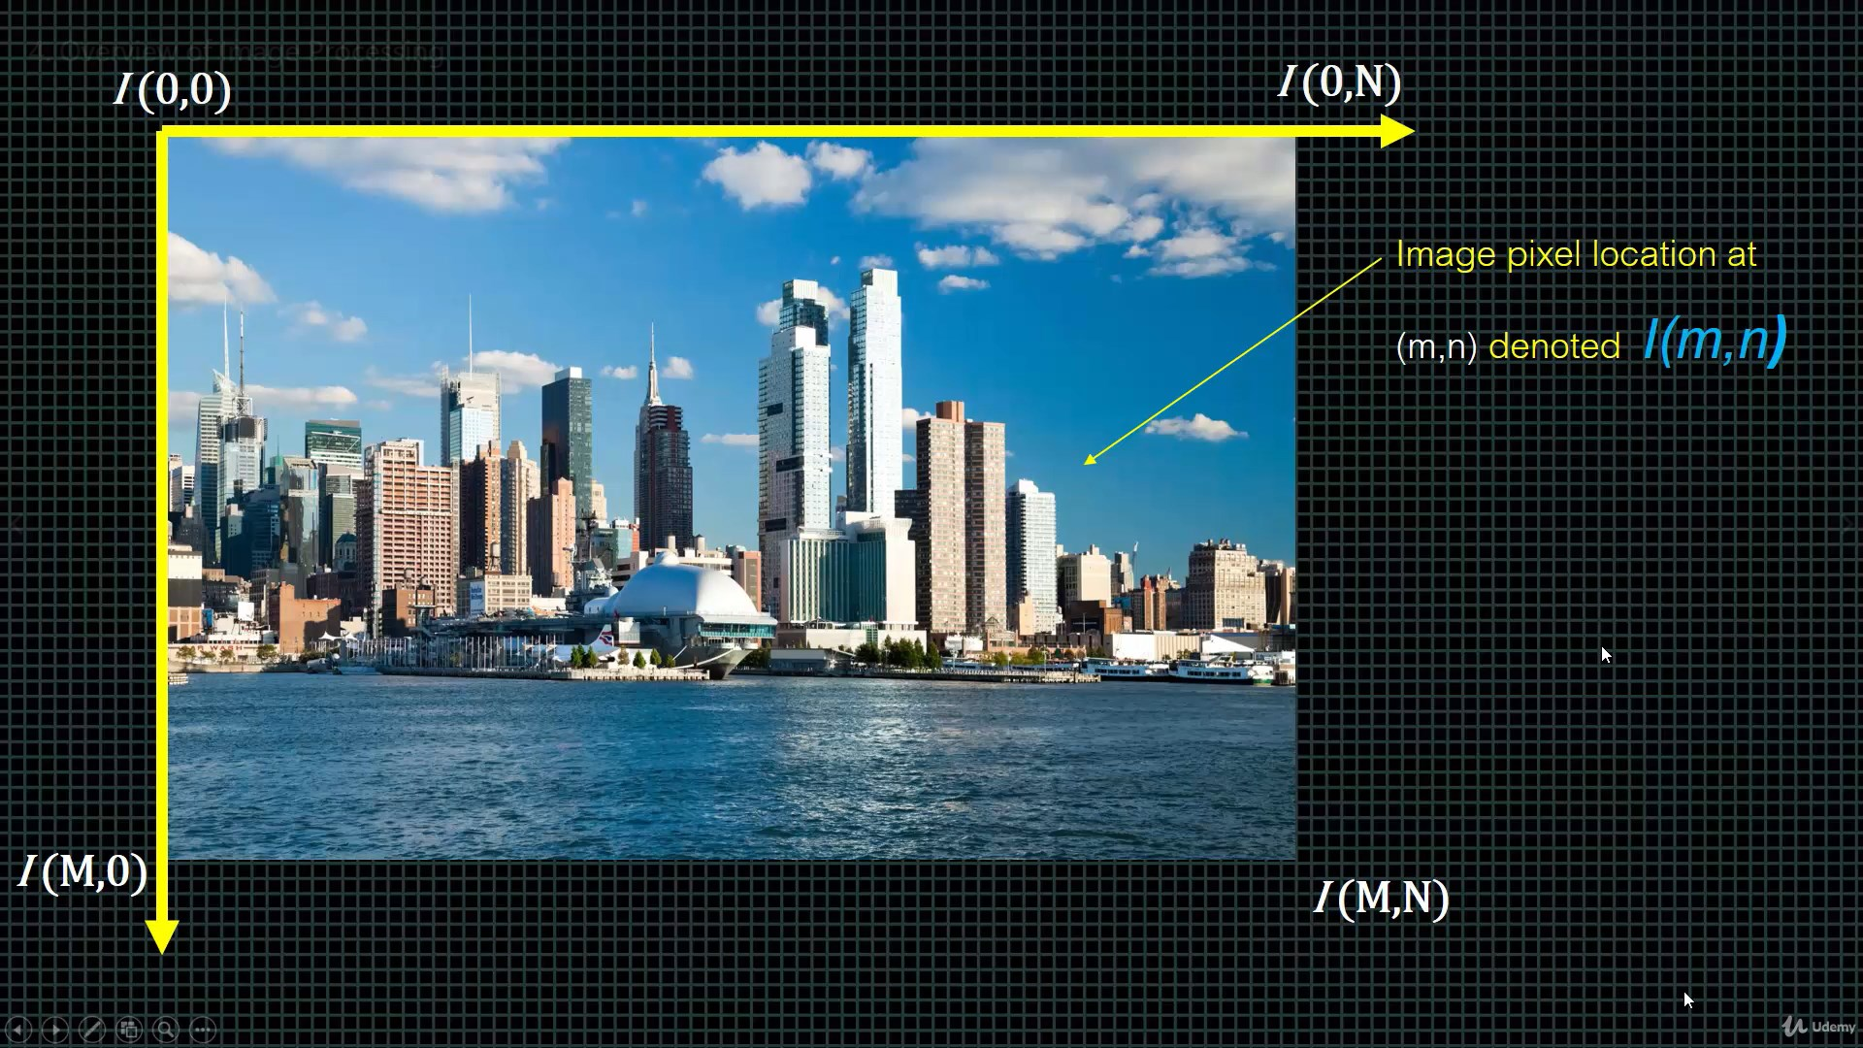
Header

Slide 13
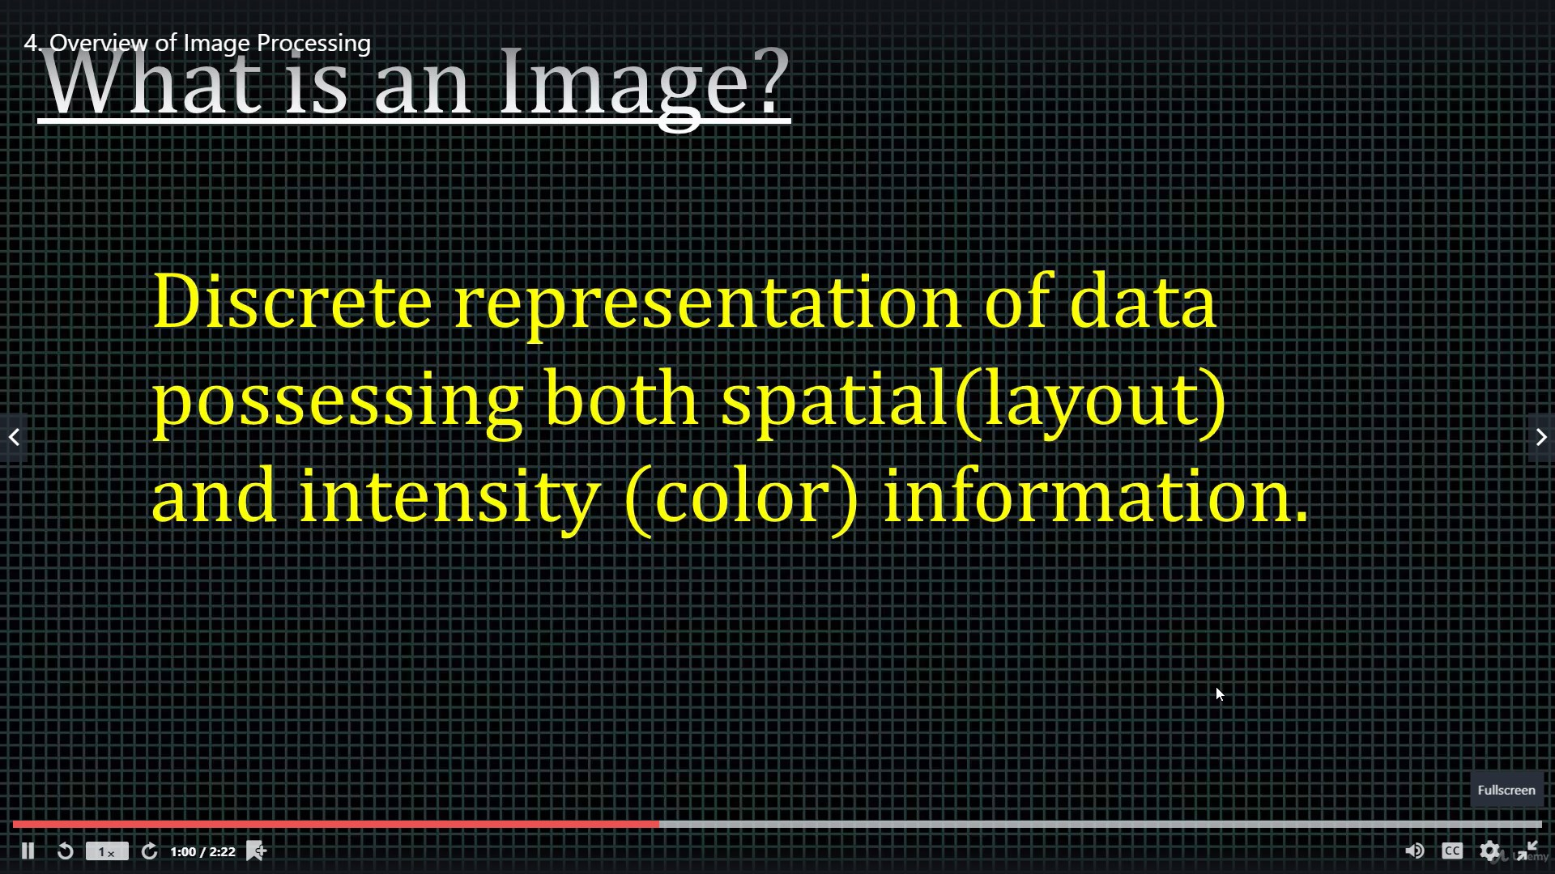
Header

Slide 14
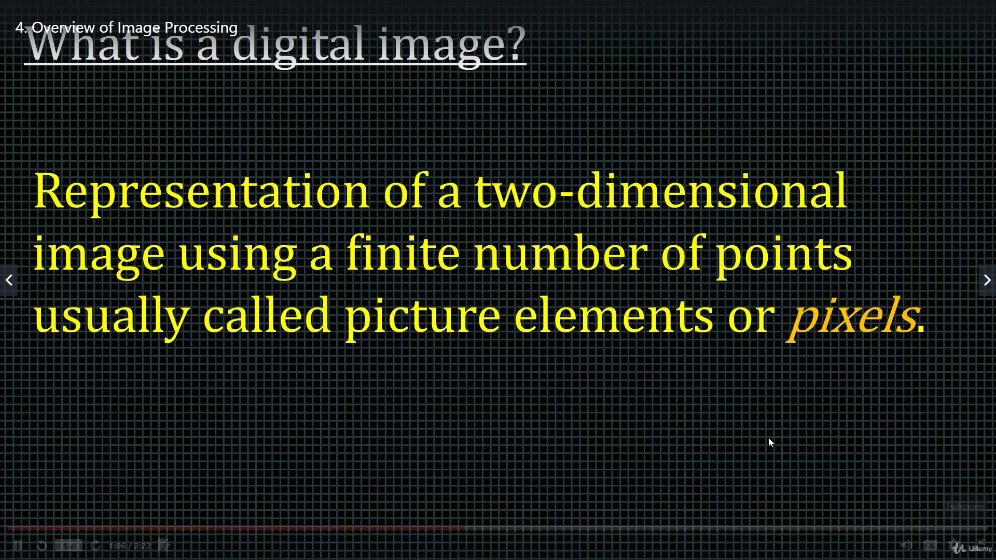
Header

Slide 15
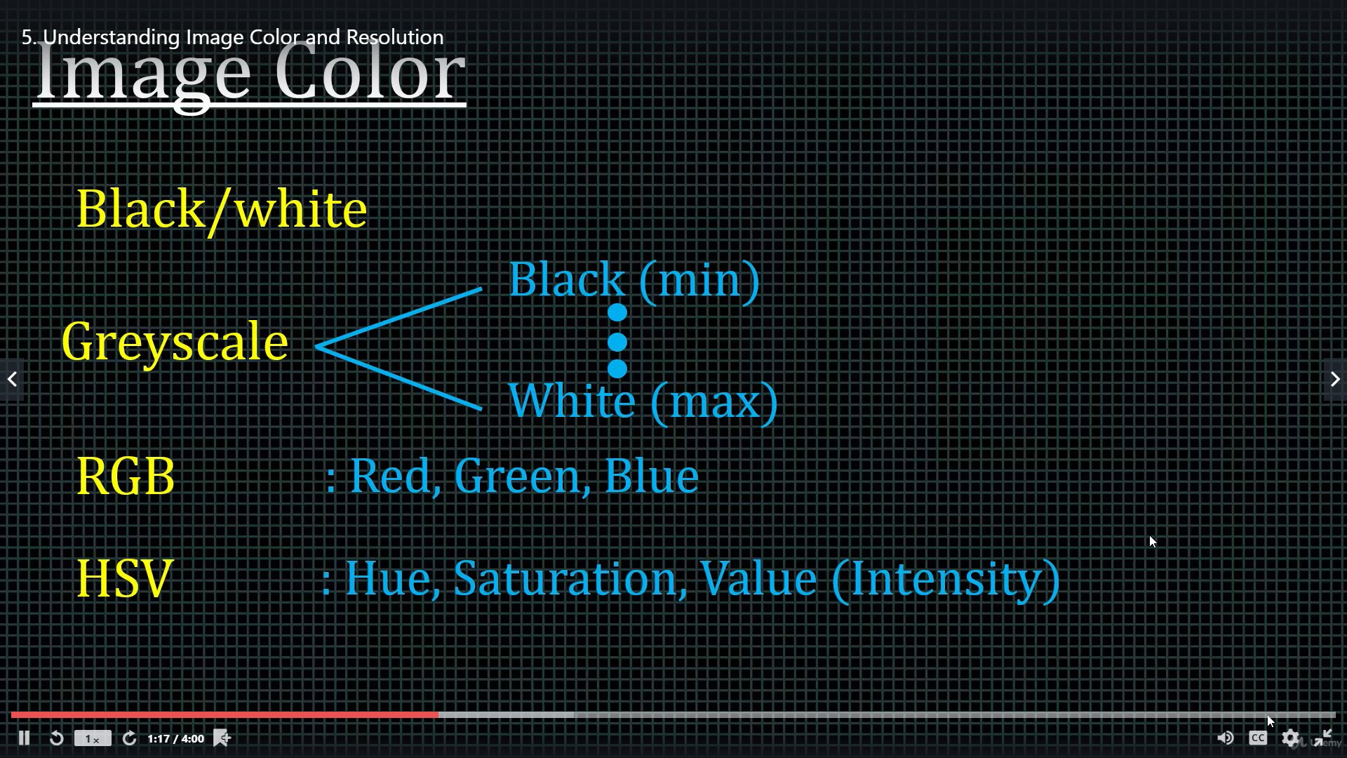
Header

Slide 16
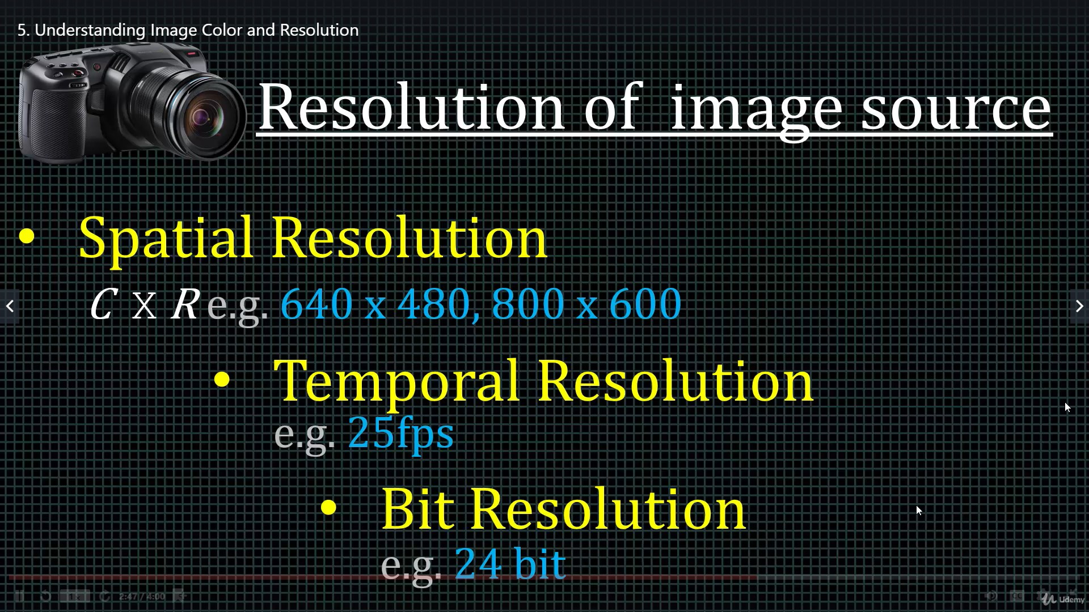
Header

Slide 17
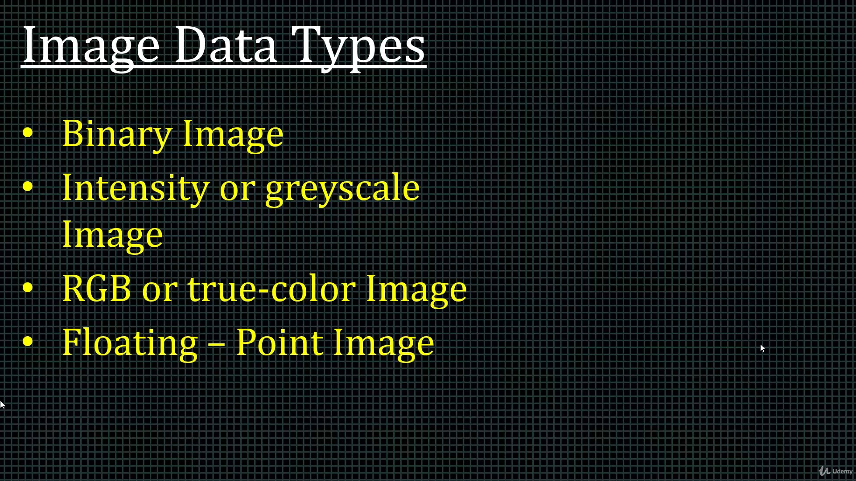
Header

Slide 18
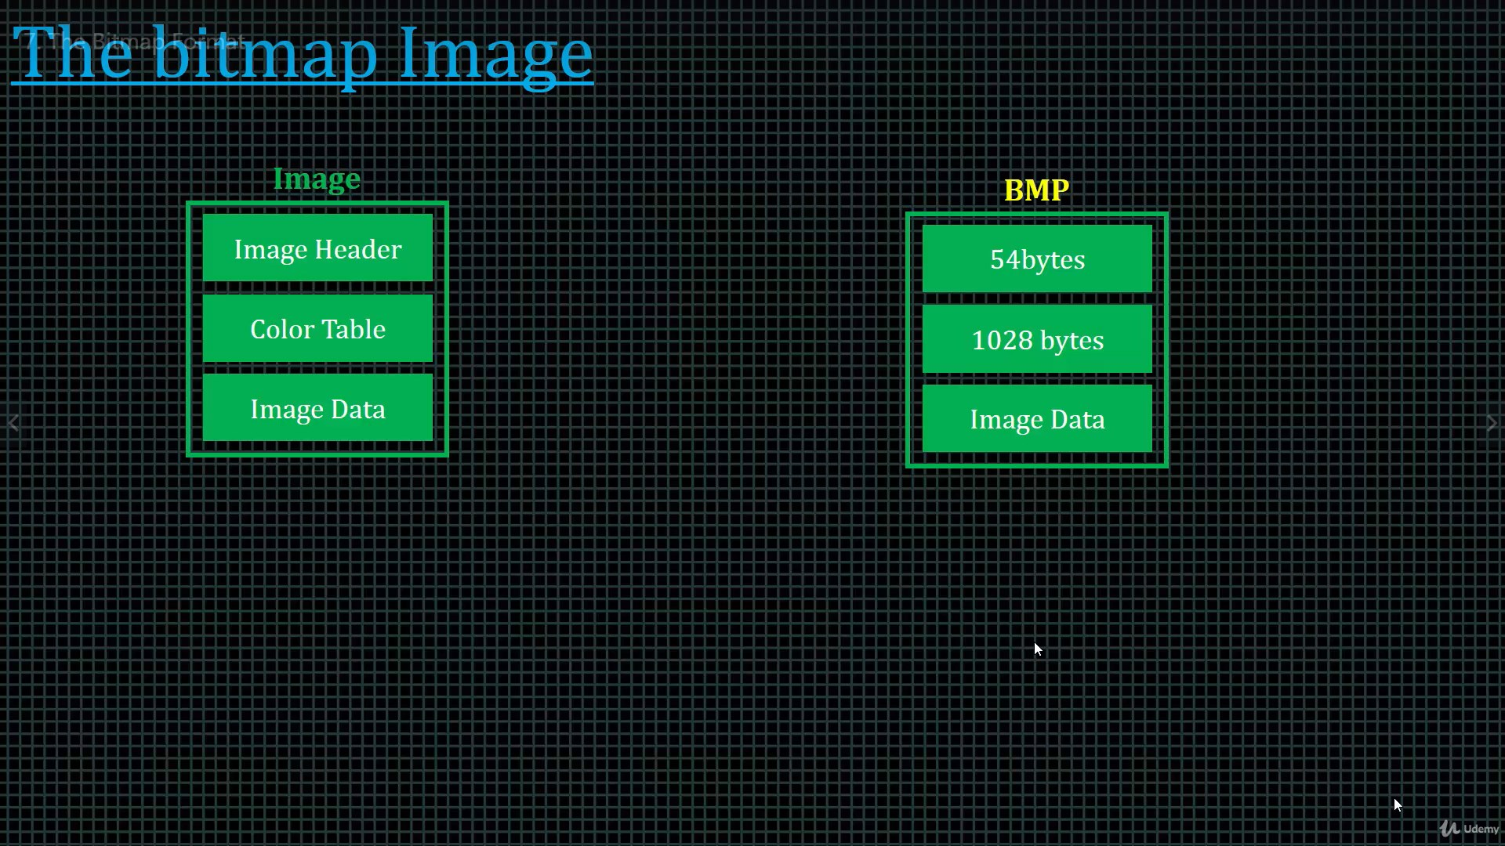
Header

Slide 19
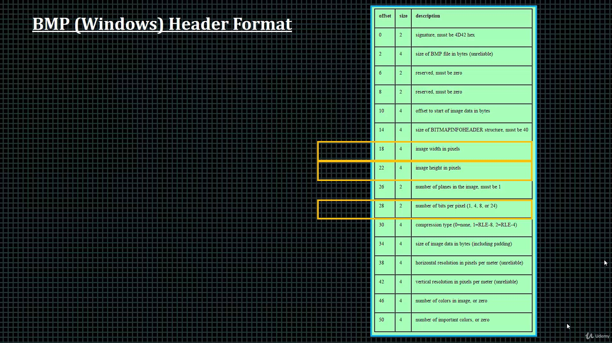
Header

Slide 20
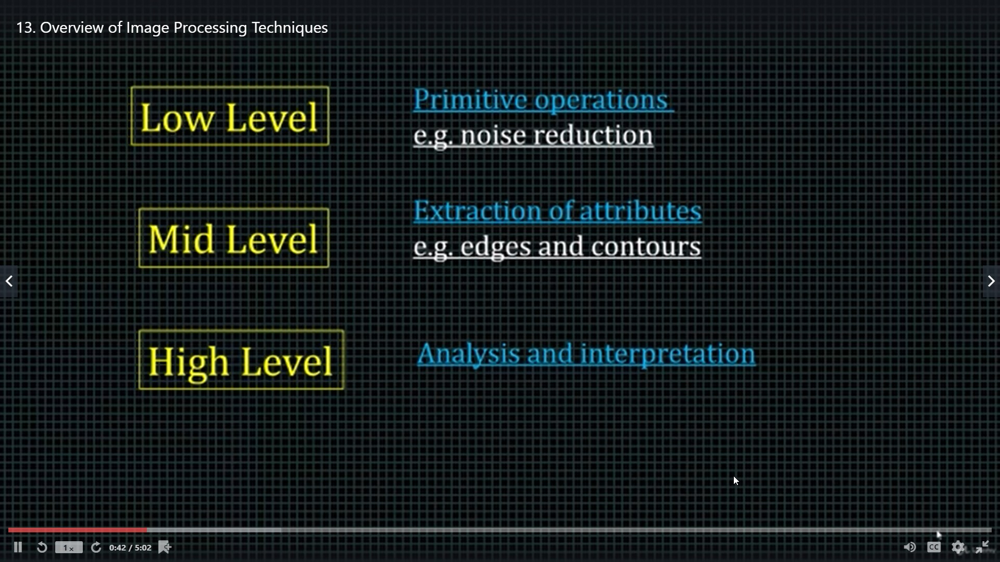
Header

Slide 21
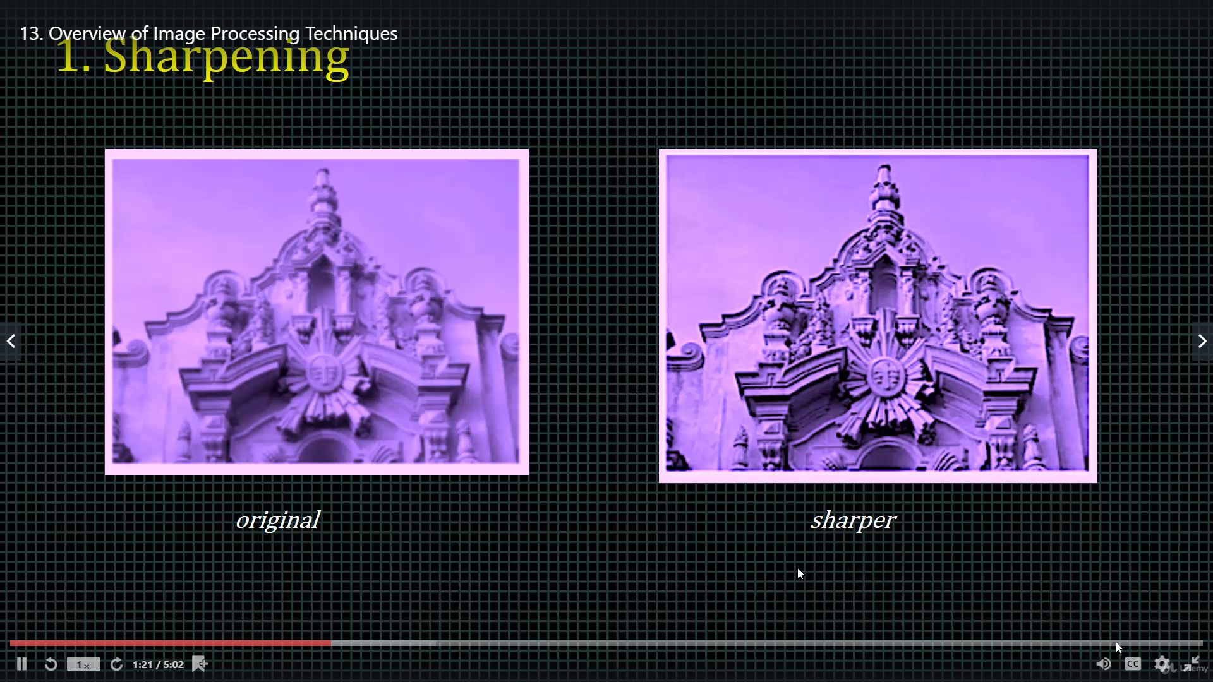
Header

Slide 22
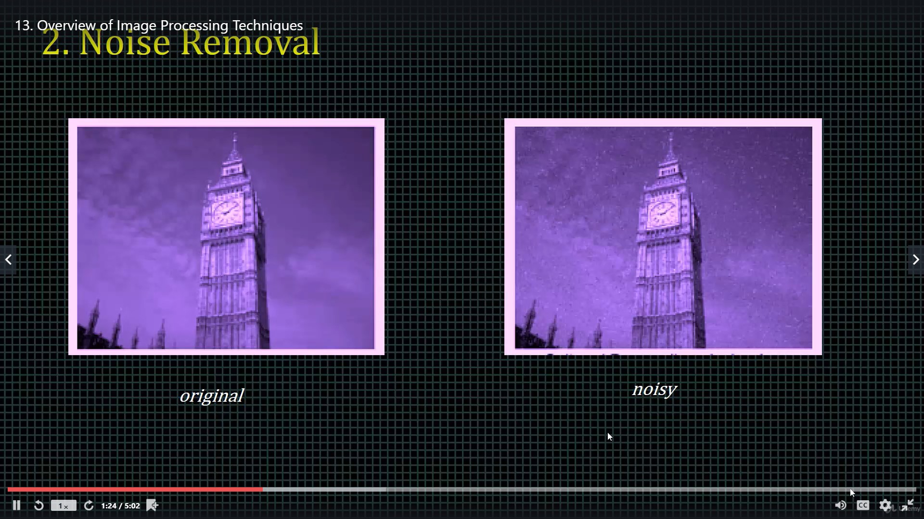
Header

Slide 23
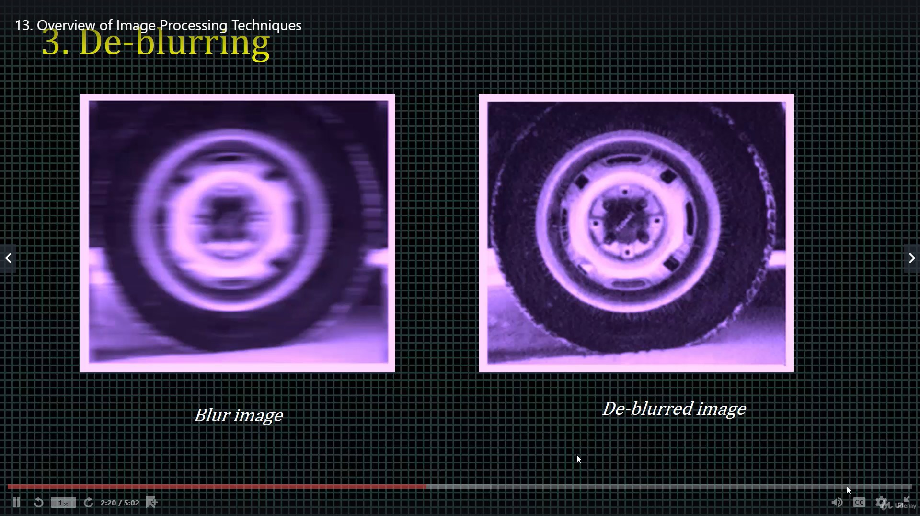
Header

Slide 24
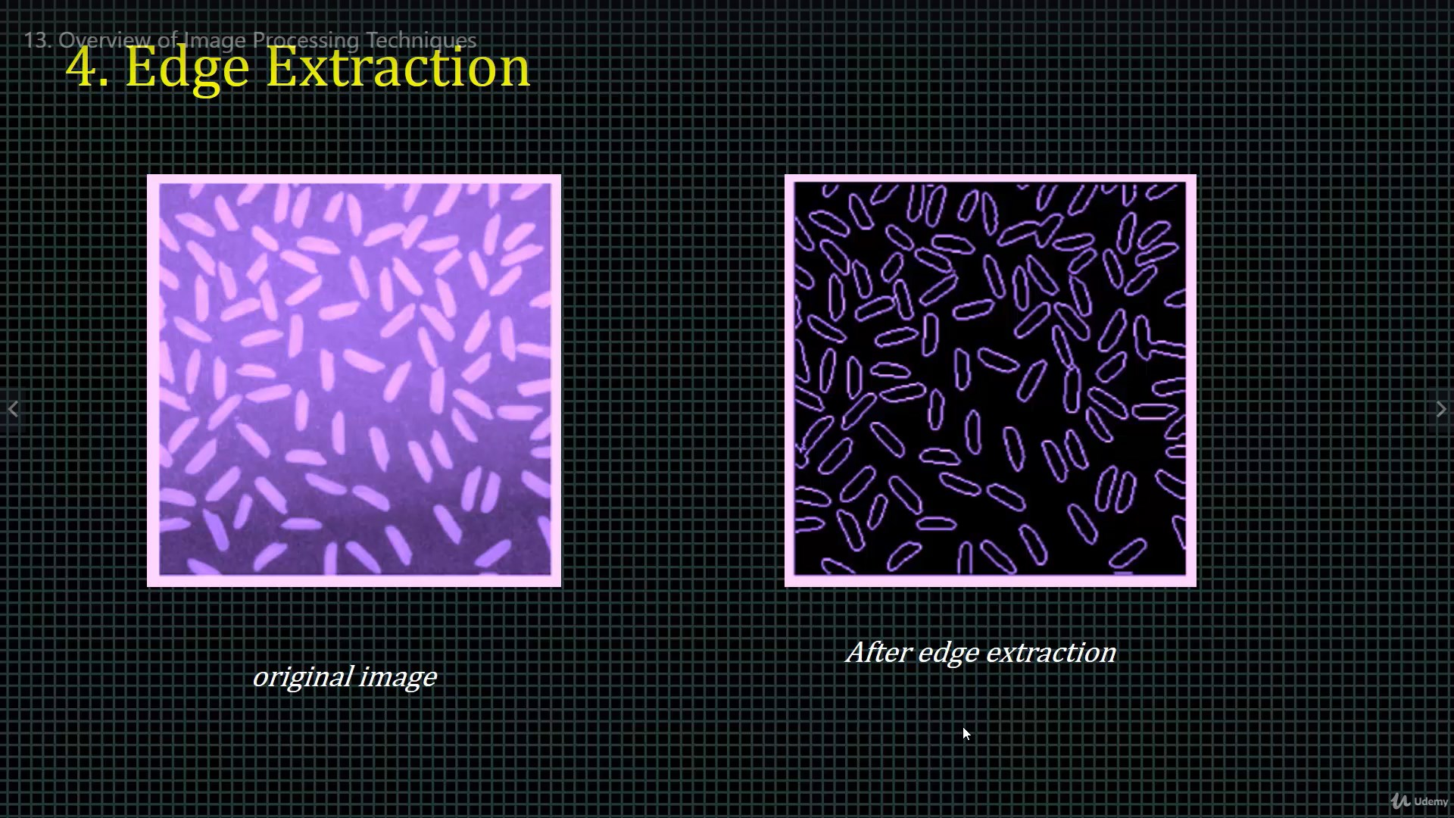
Header

Slide 25
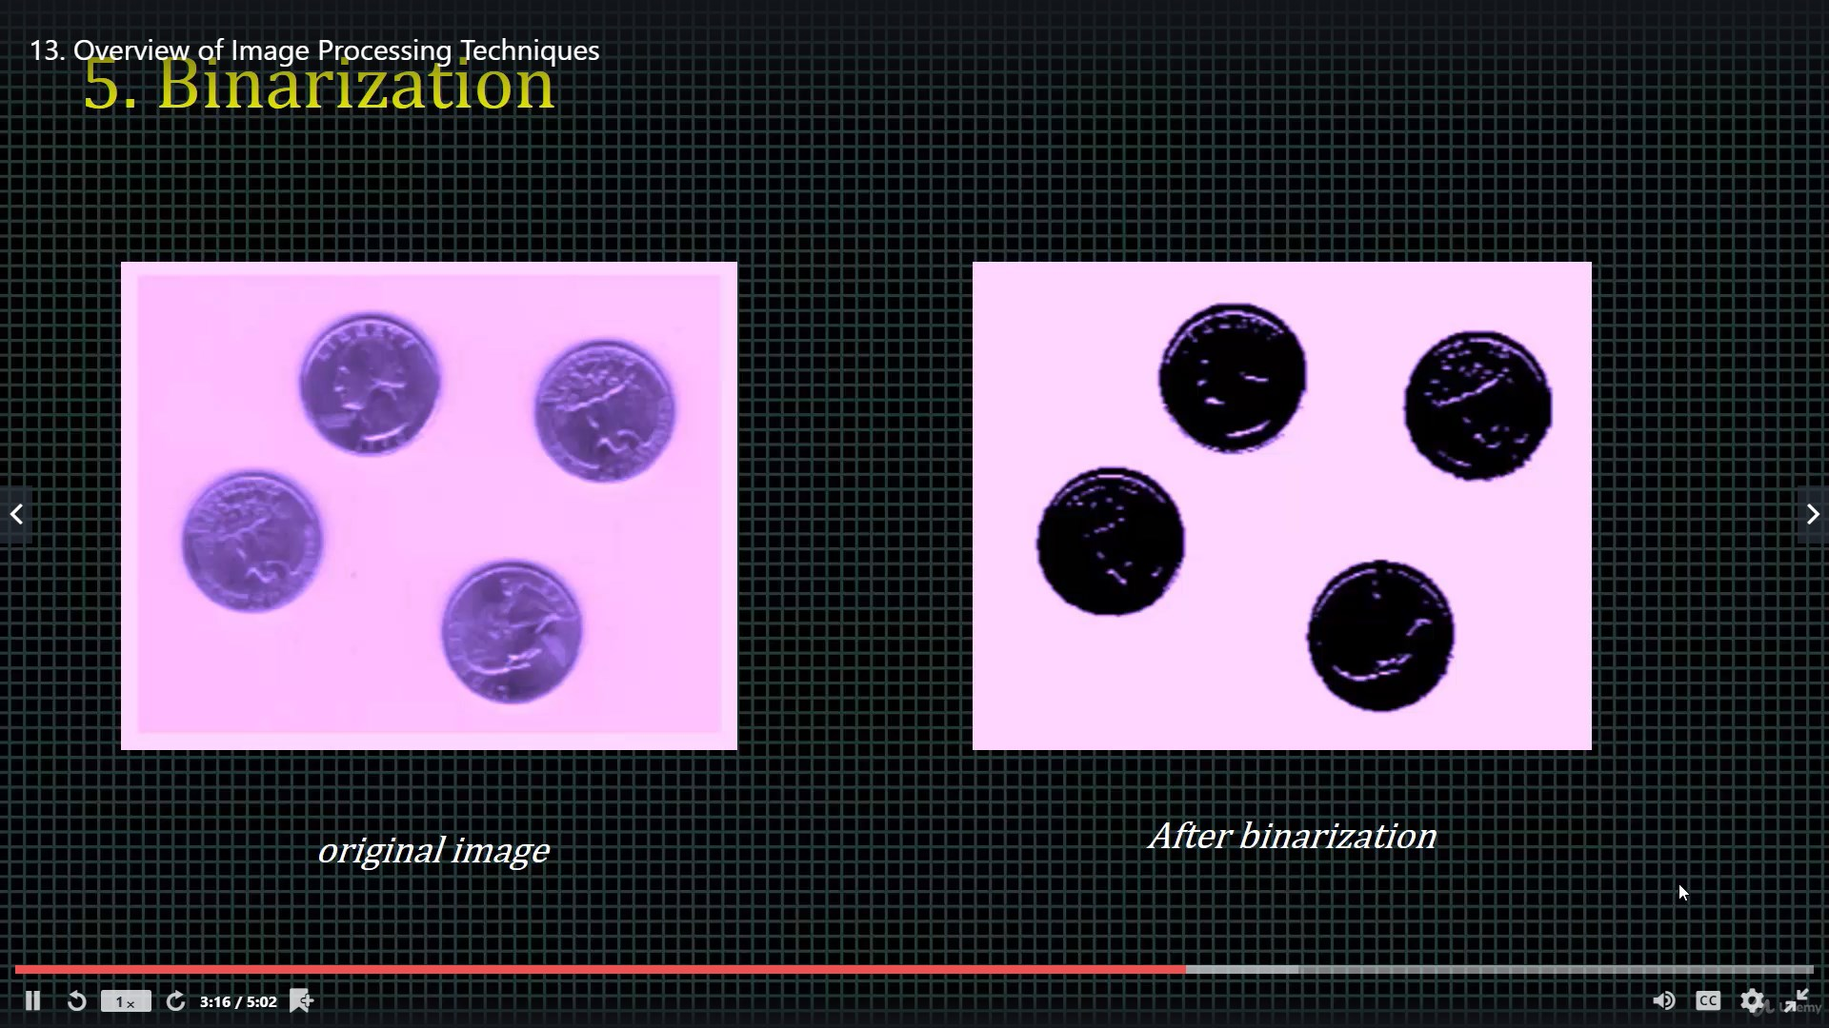
Header

Slide 26
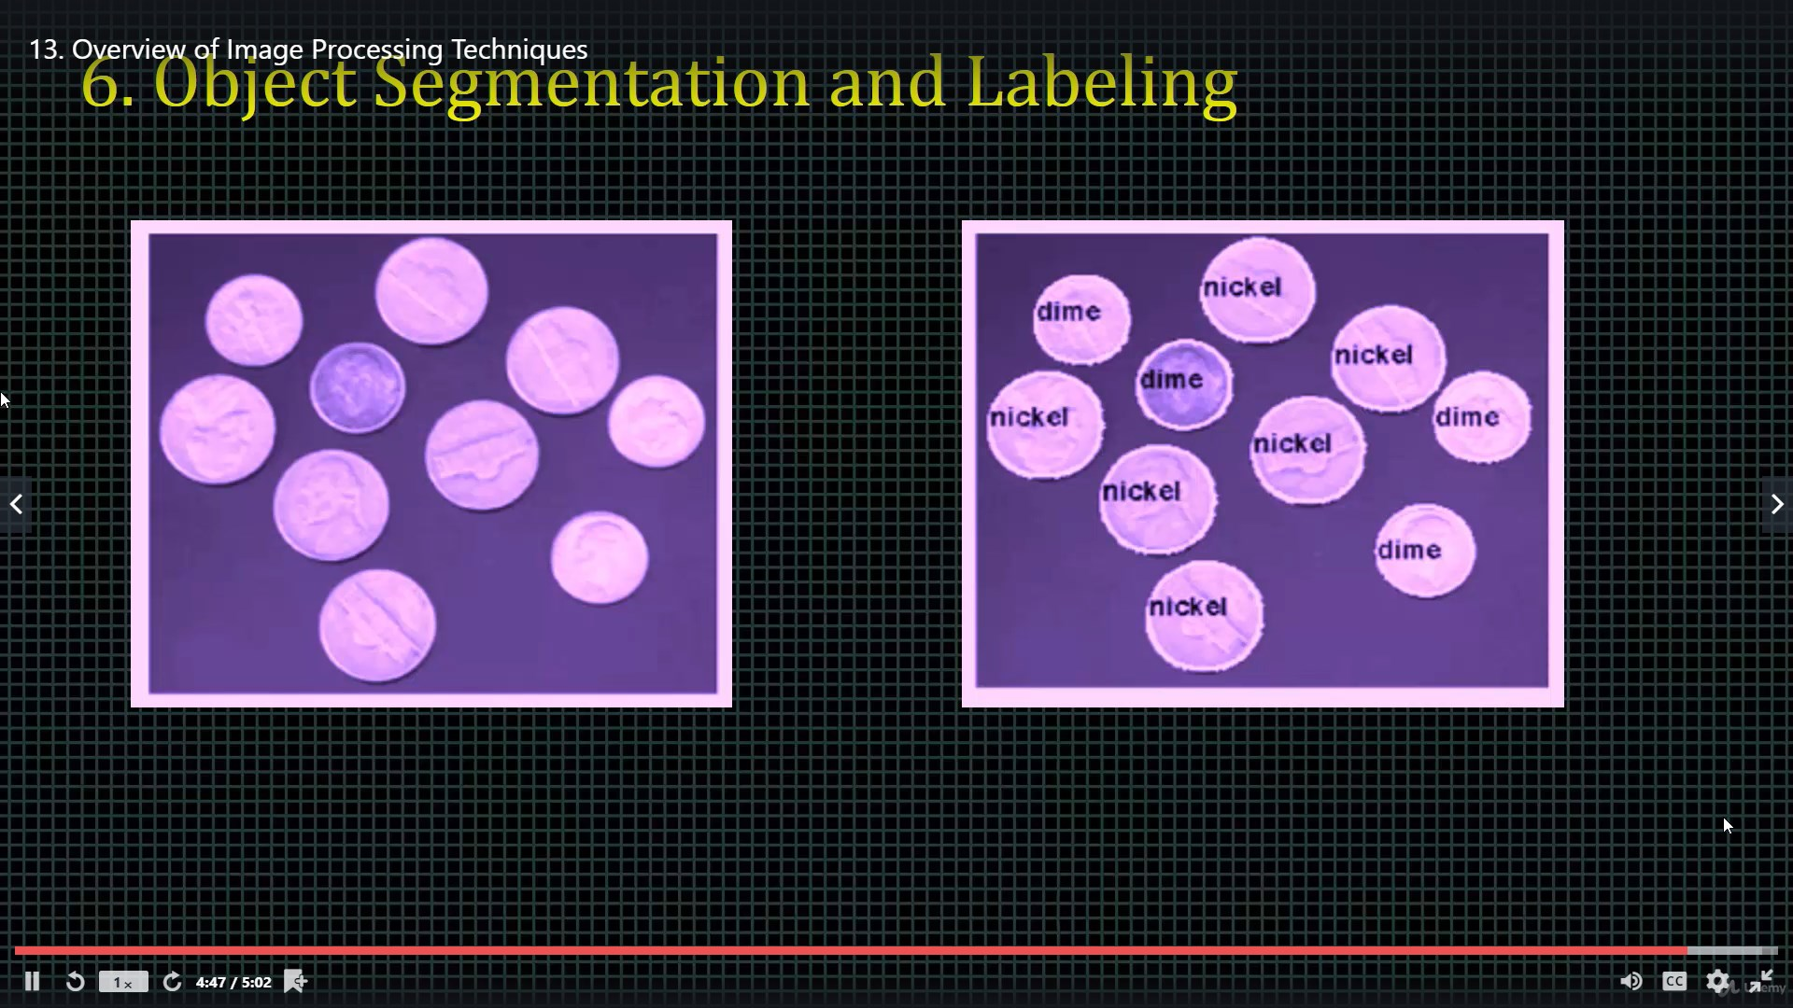
Header

Slide 27
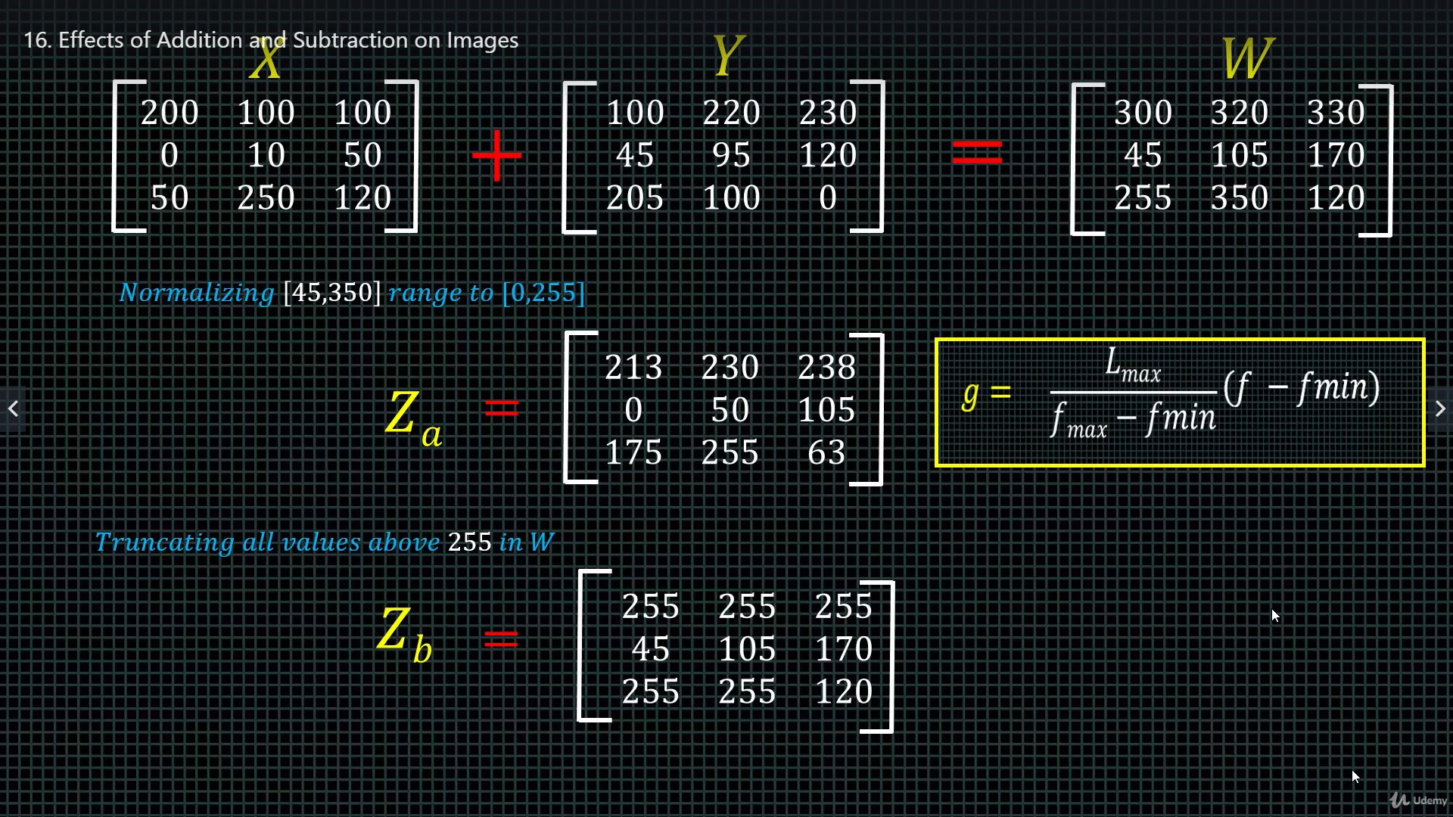
Header

Slide 28
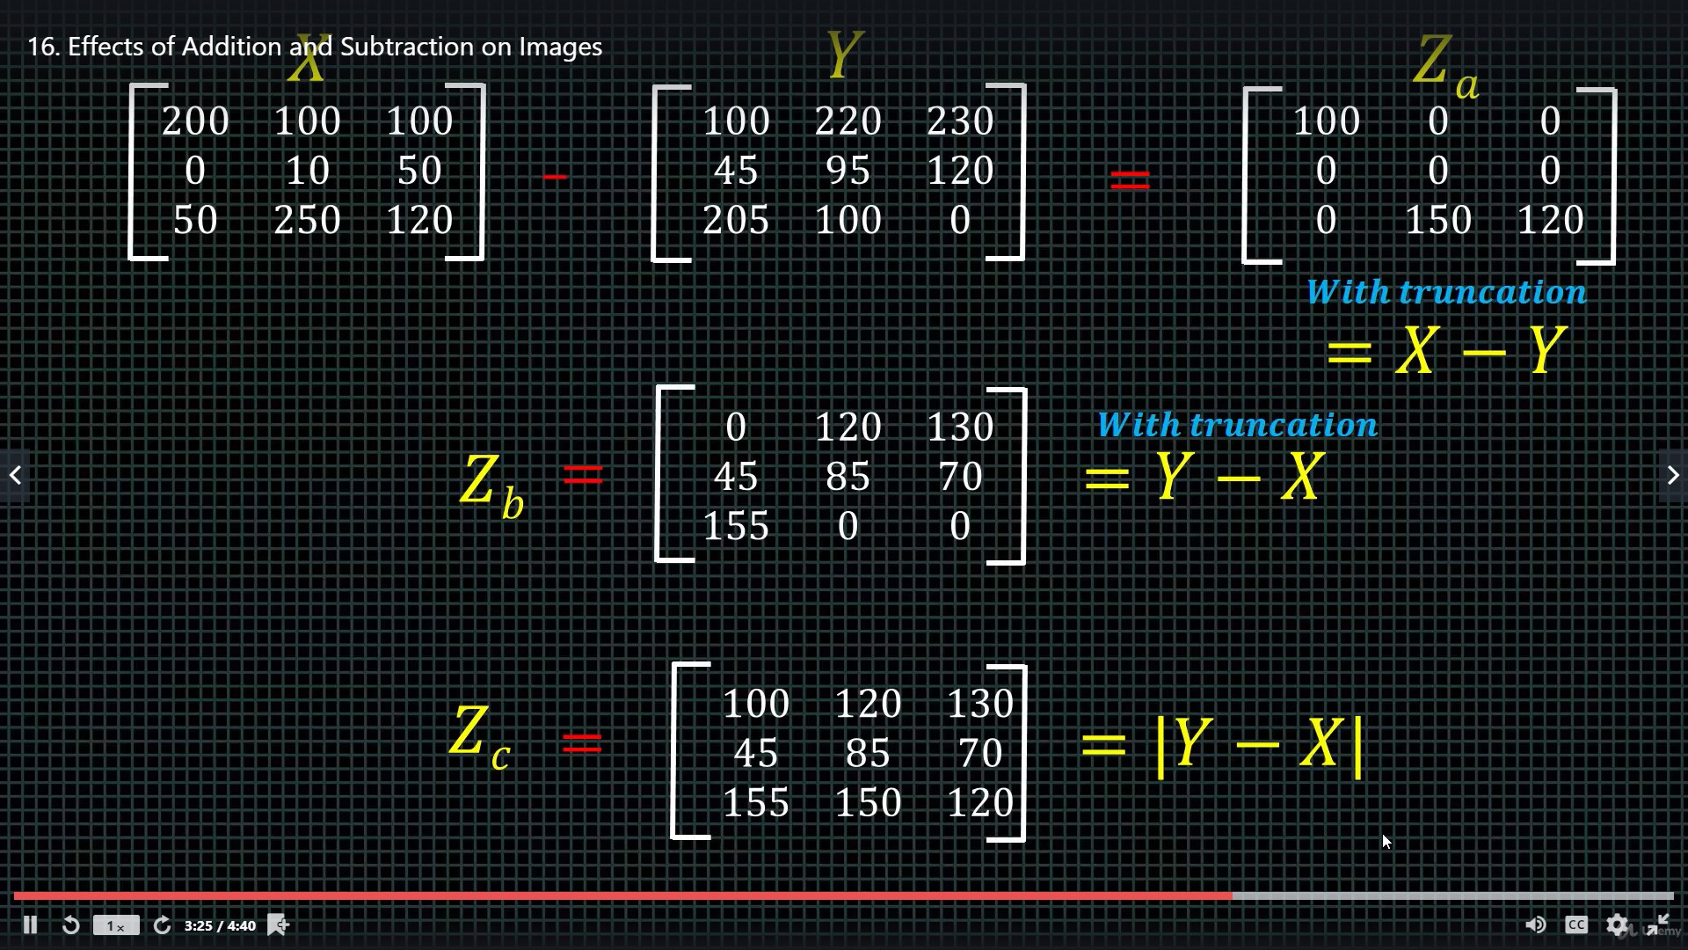
Header

Slide 29
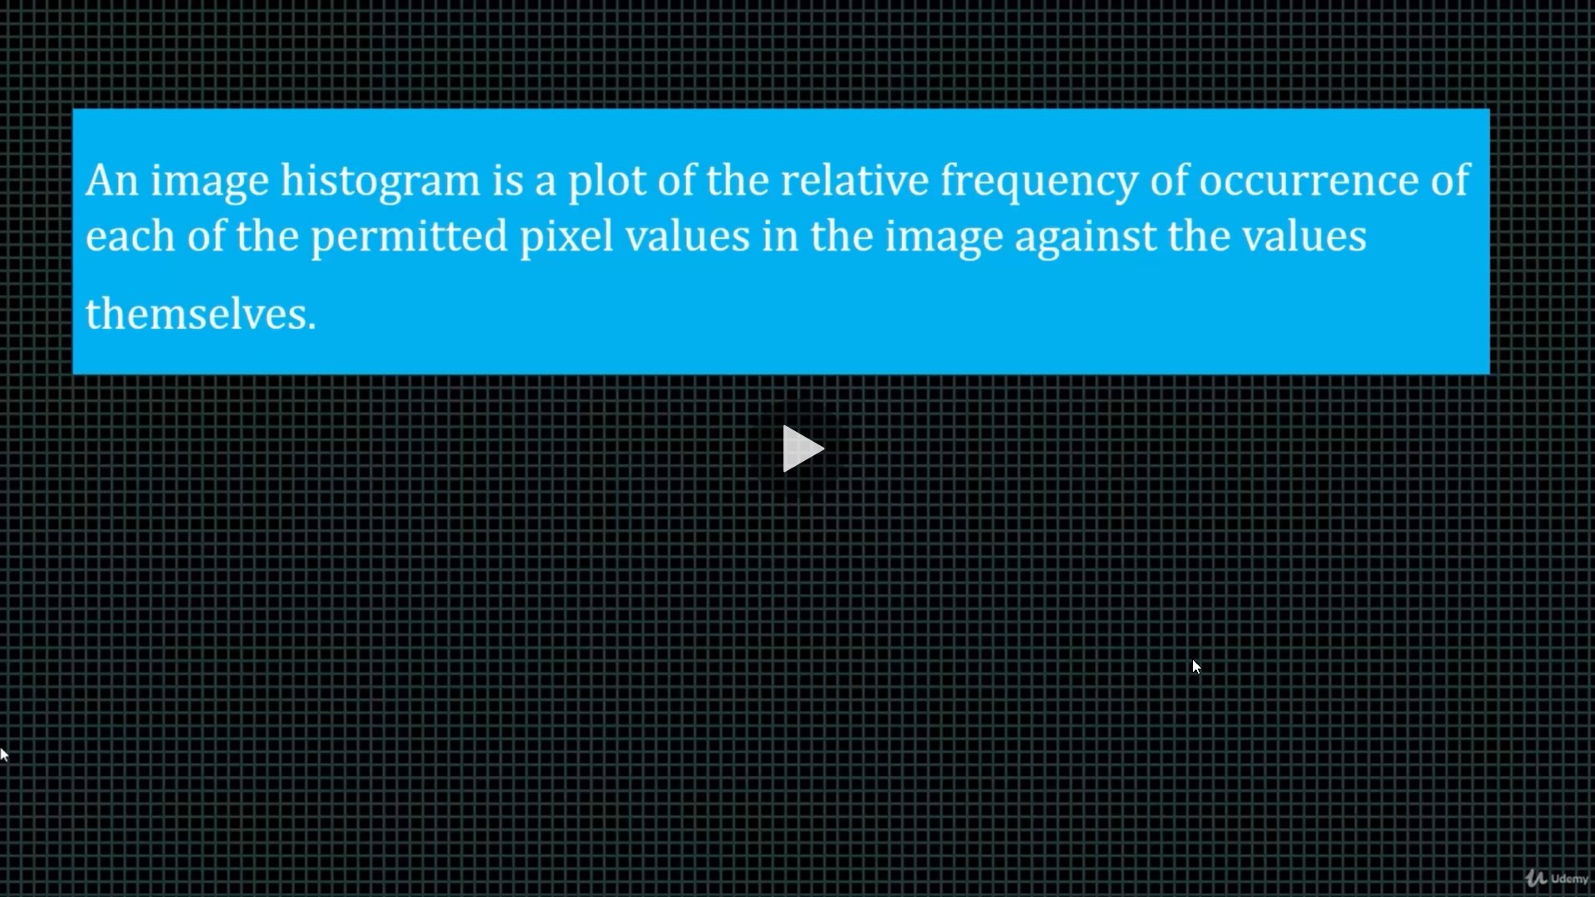
Header

Slide 30
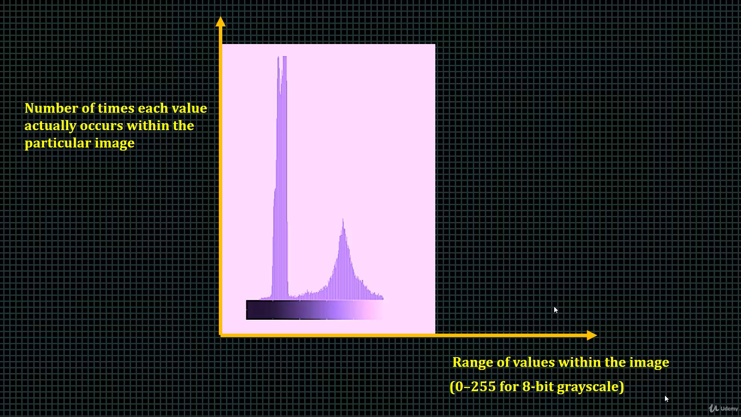
Header

Slide 31
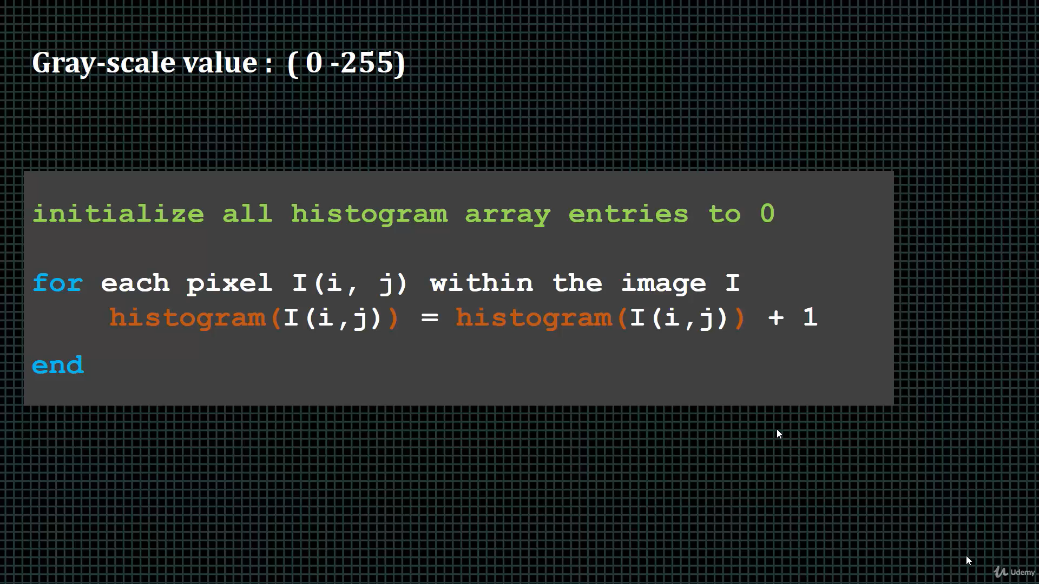
Header

Slide 32
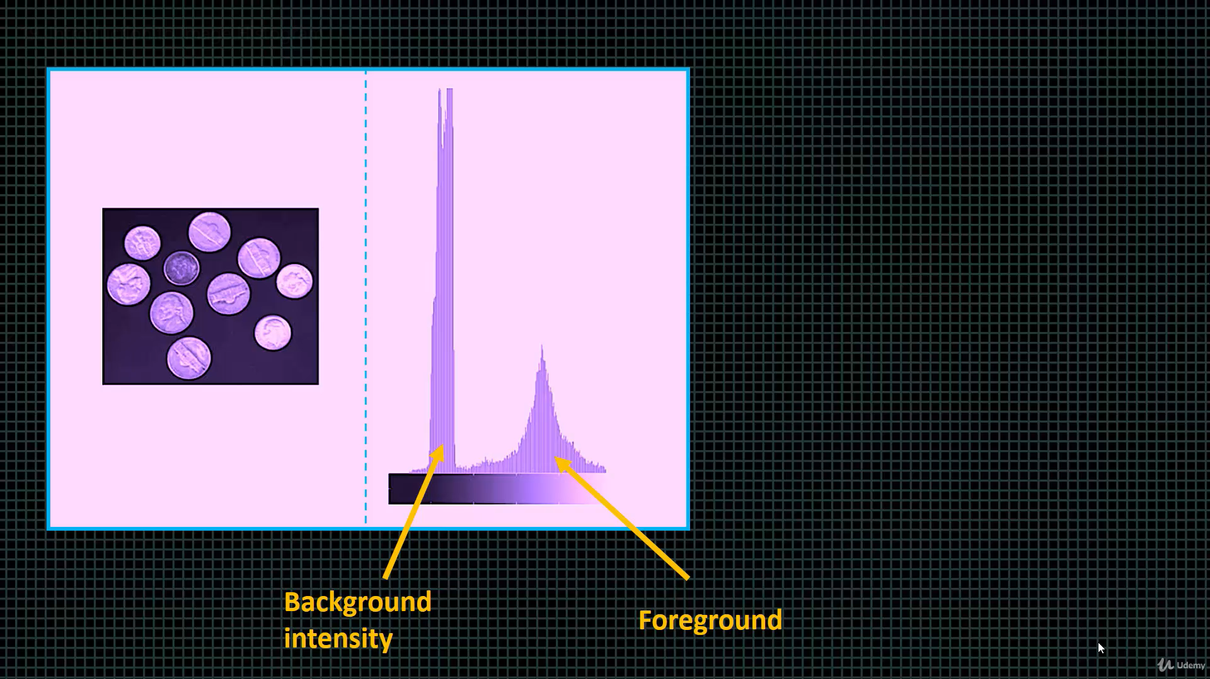
Header

Slide 33
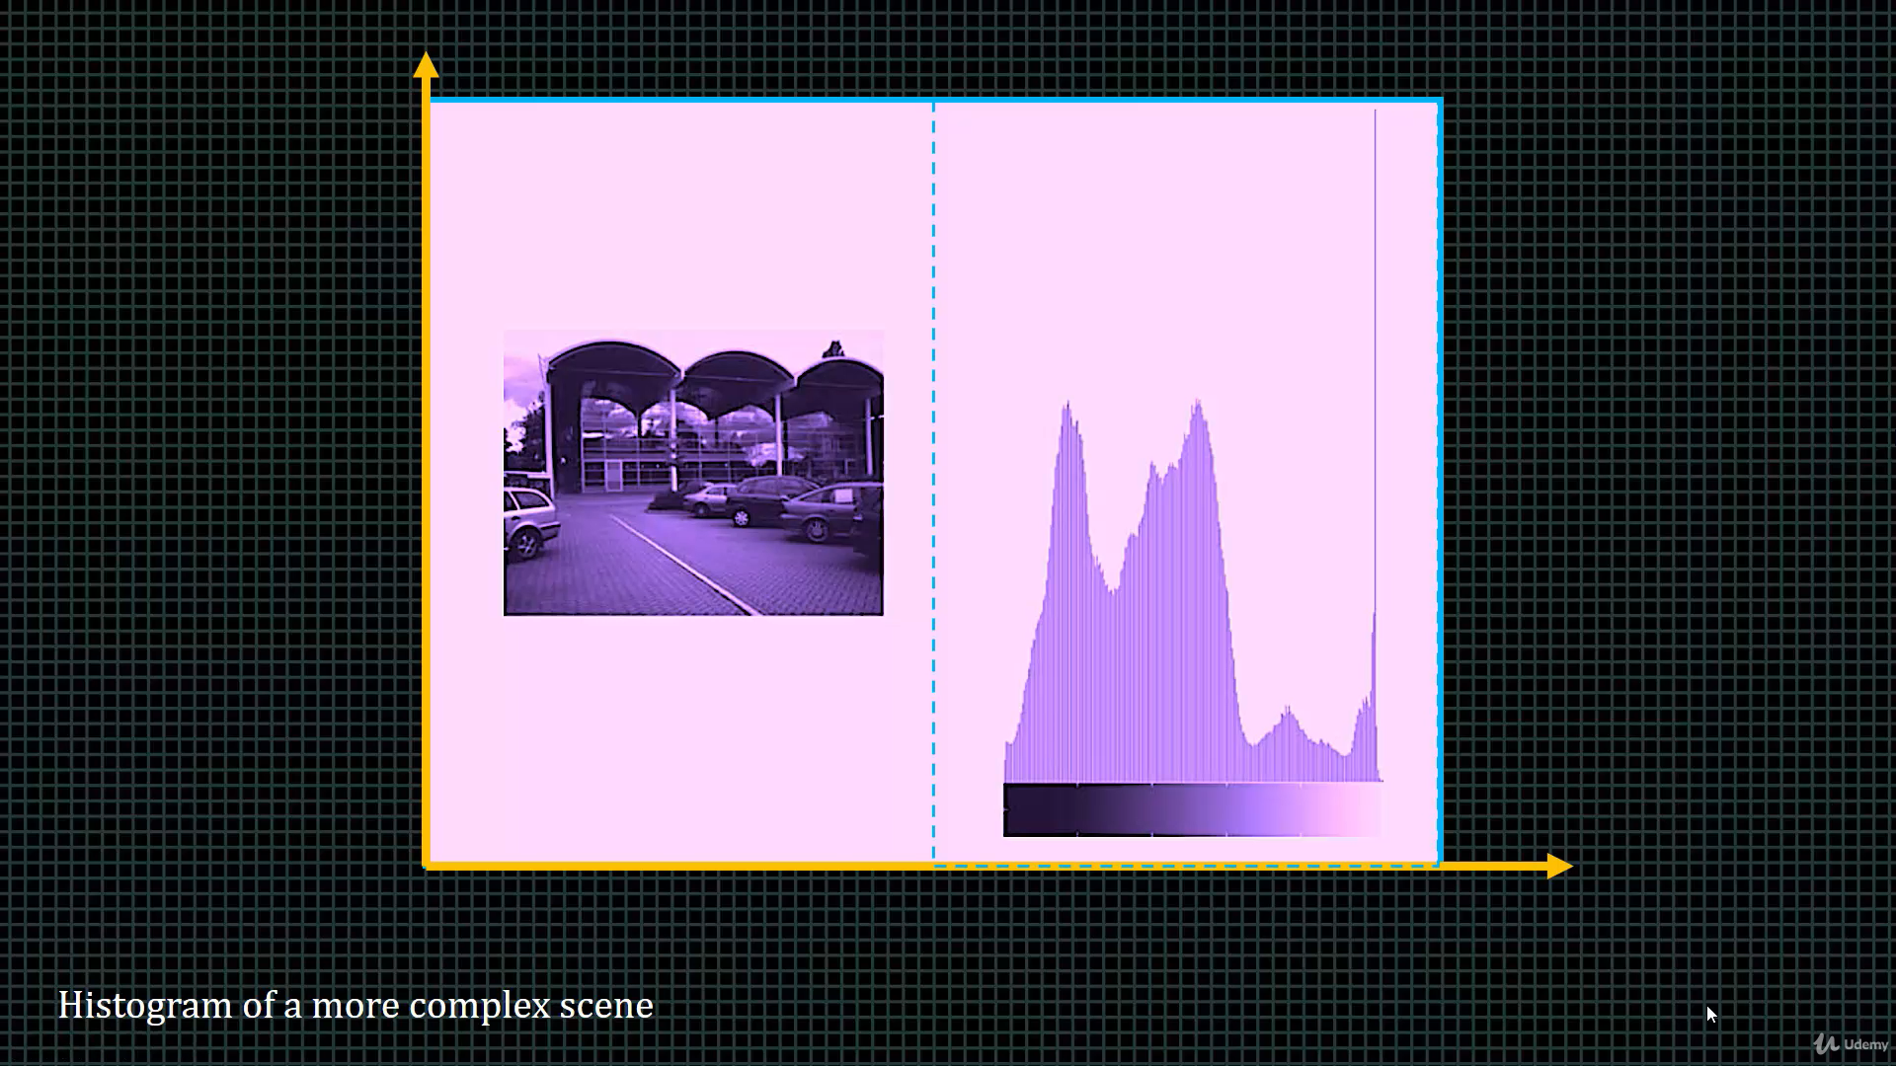
Header

Slide 34
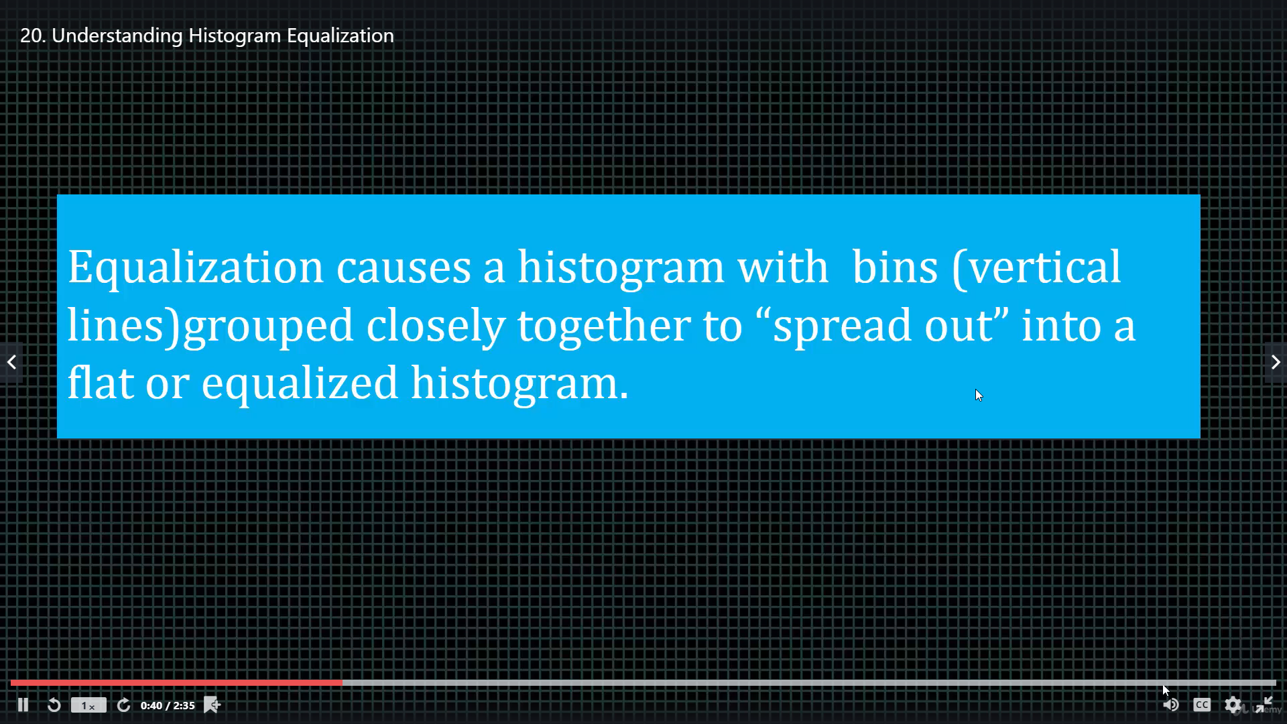
Header

Slide 35
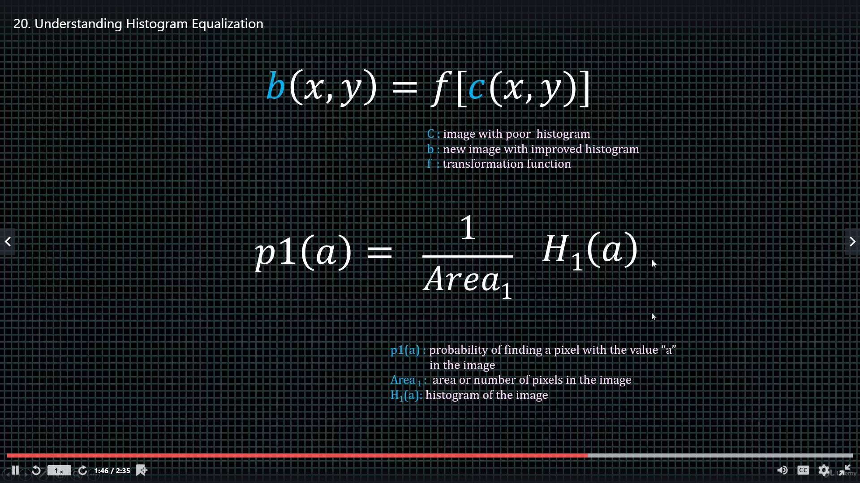
Header

Slide 36
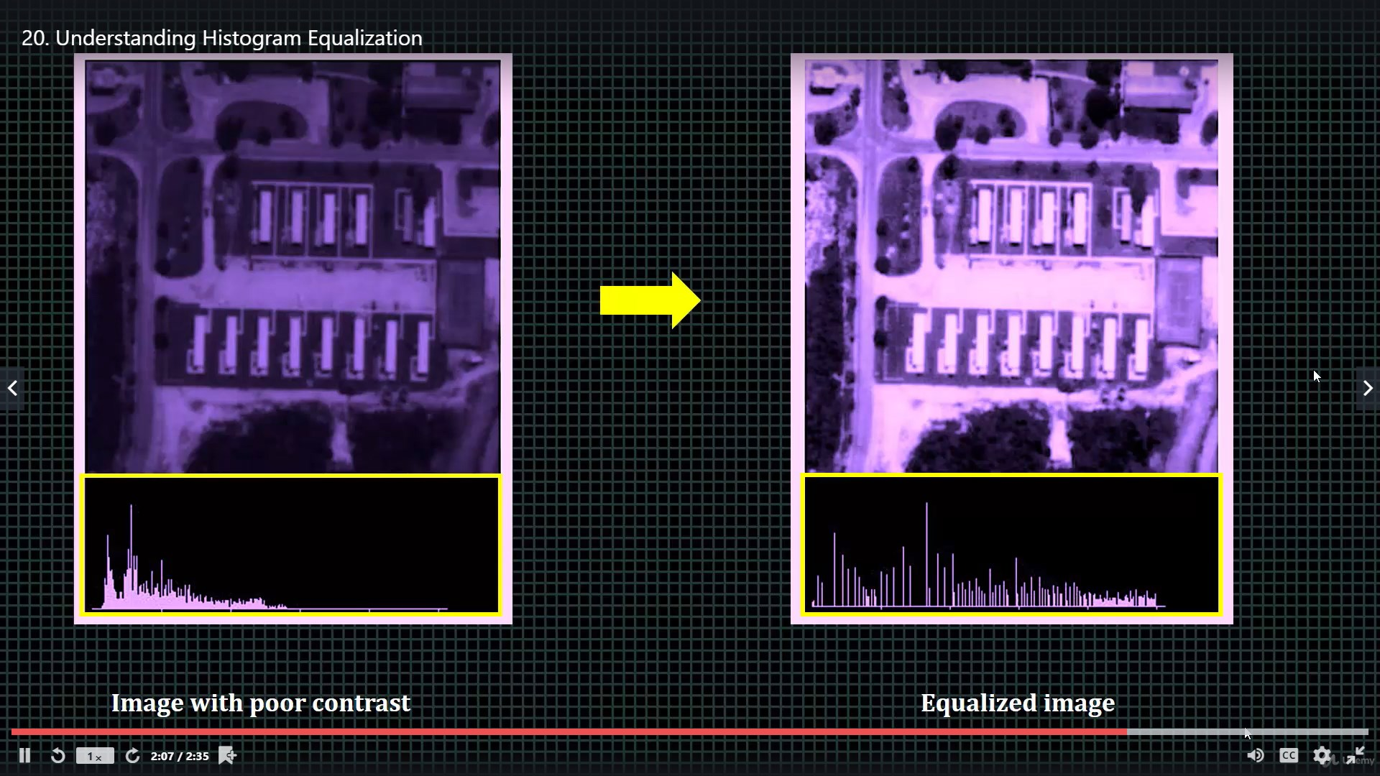
Header

Slide 37
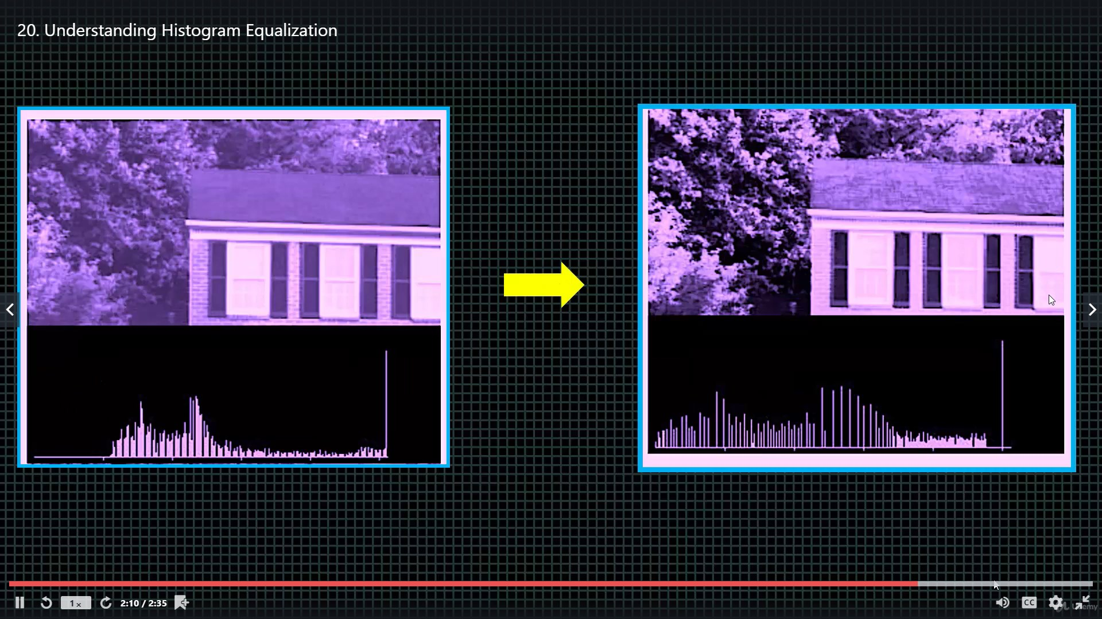
Header

Slide 38
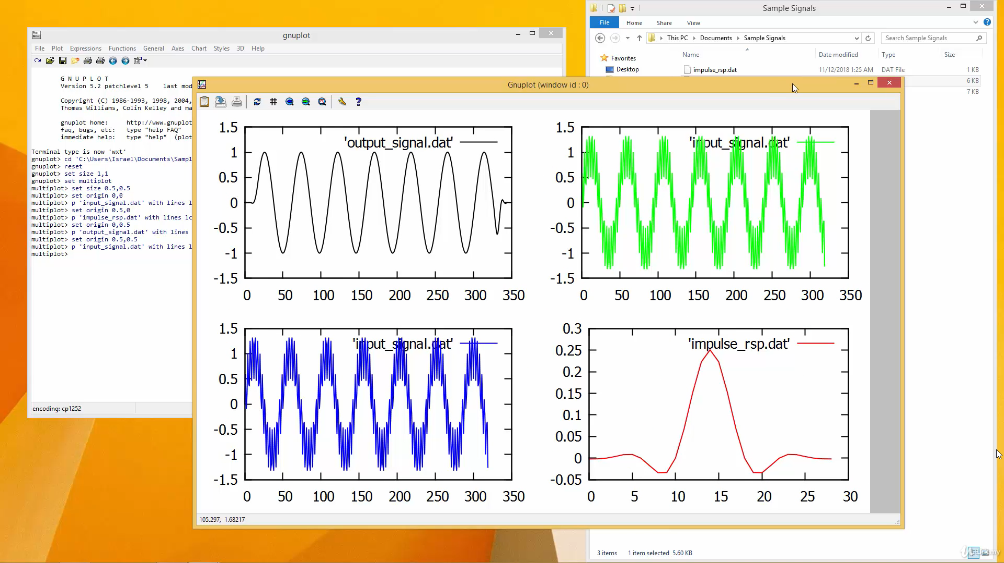
Header

Slide 39
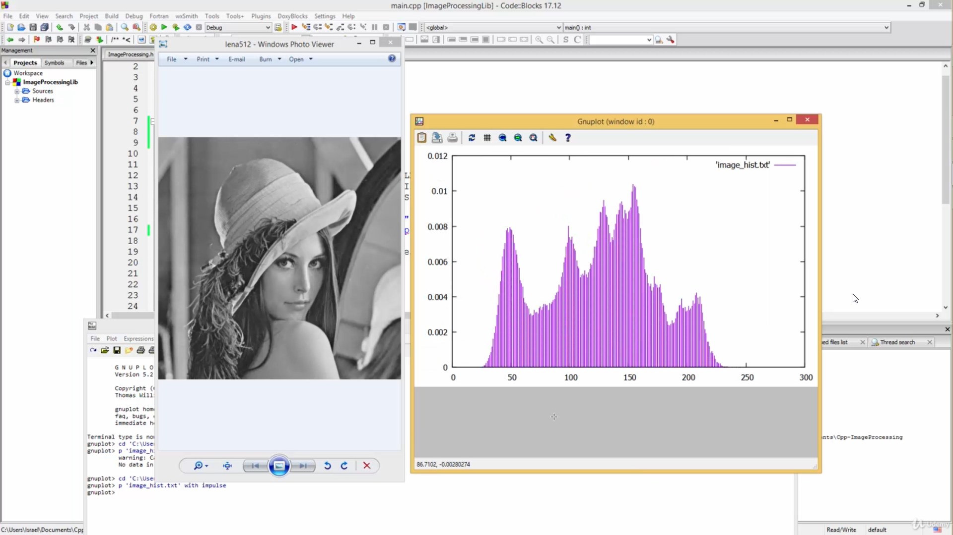
Header

Slide 40
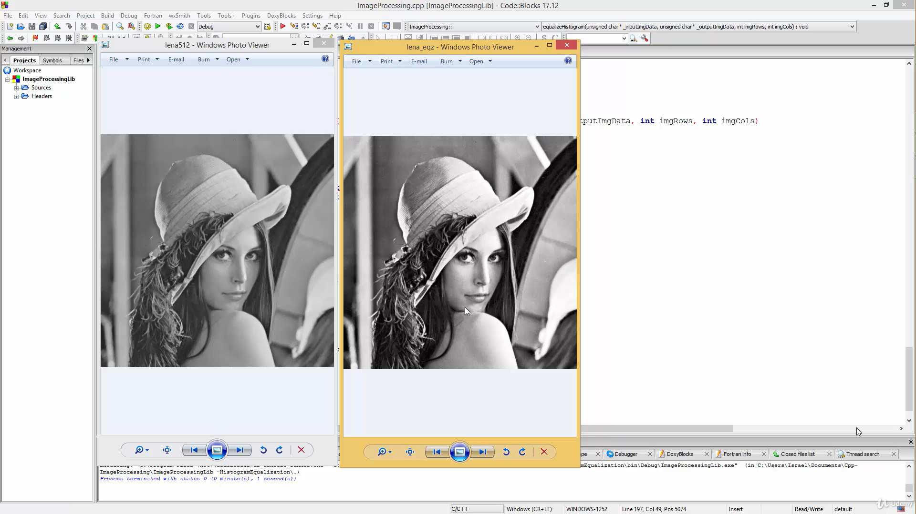
Header

Slide 41
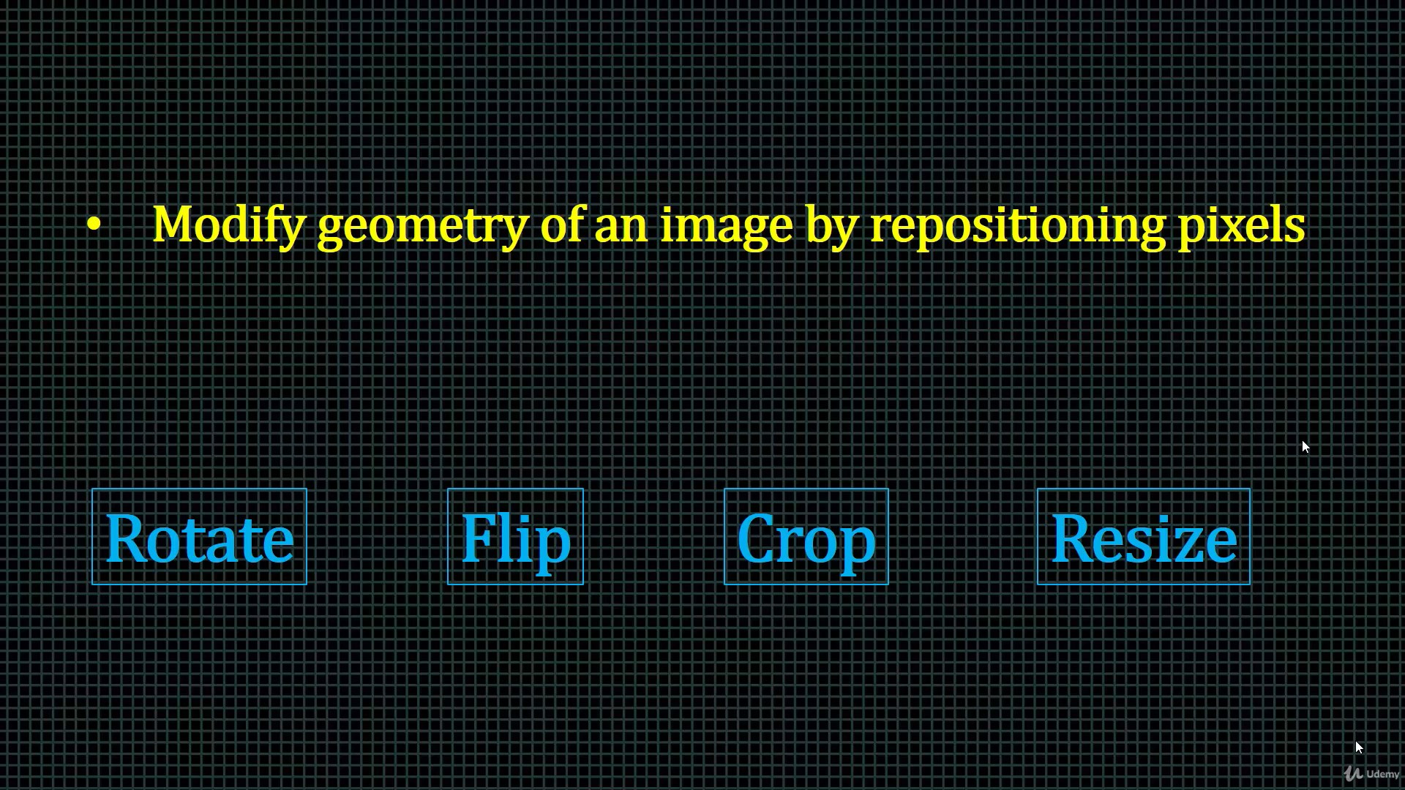
Header

Slide 42
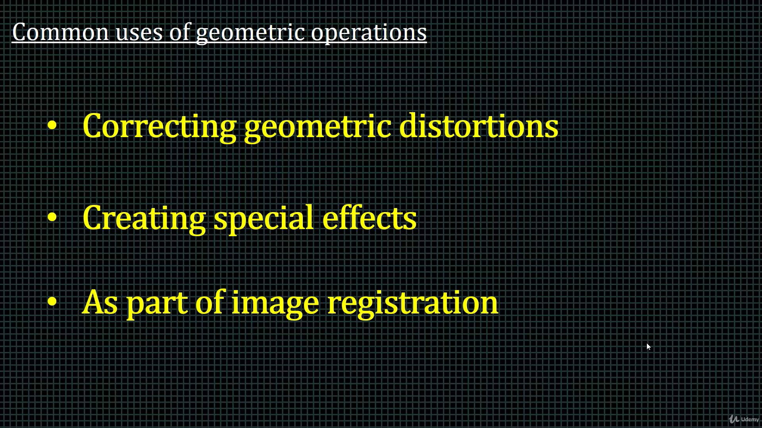
Header

Slide 43
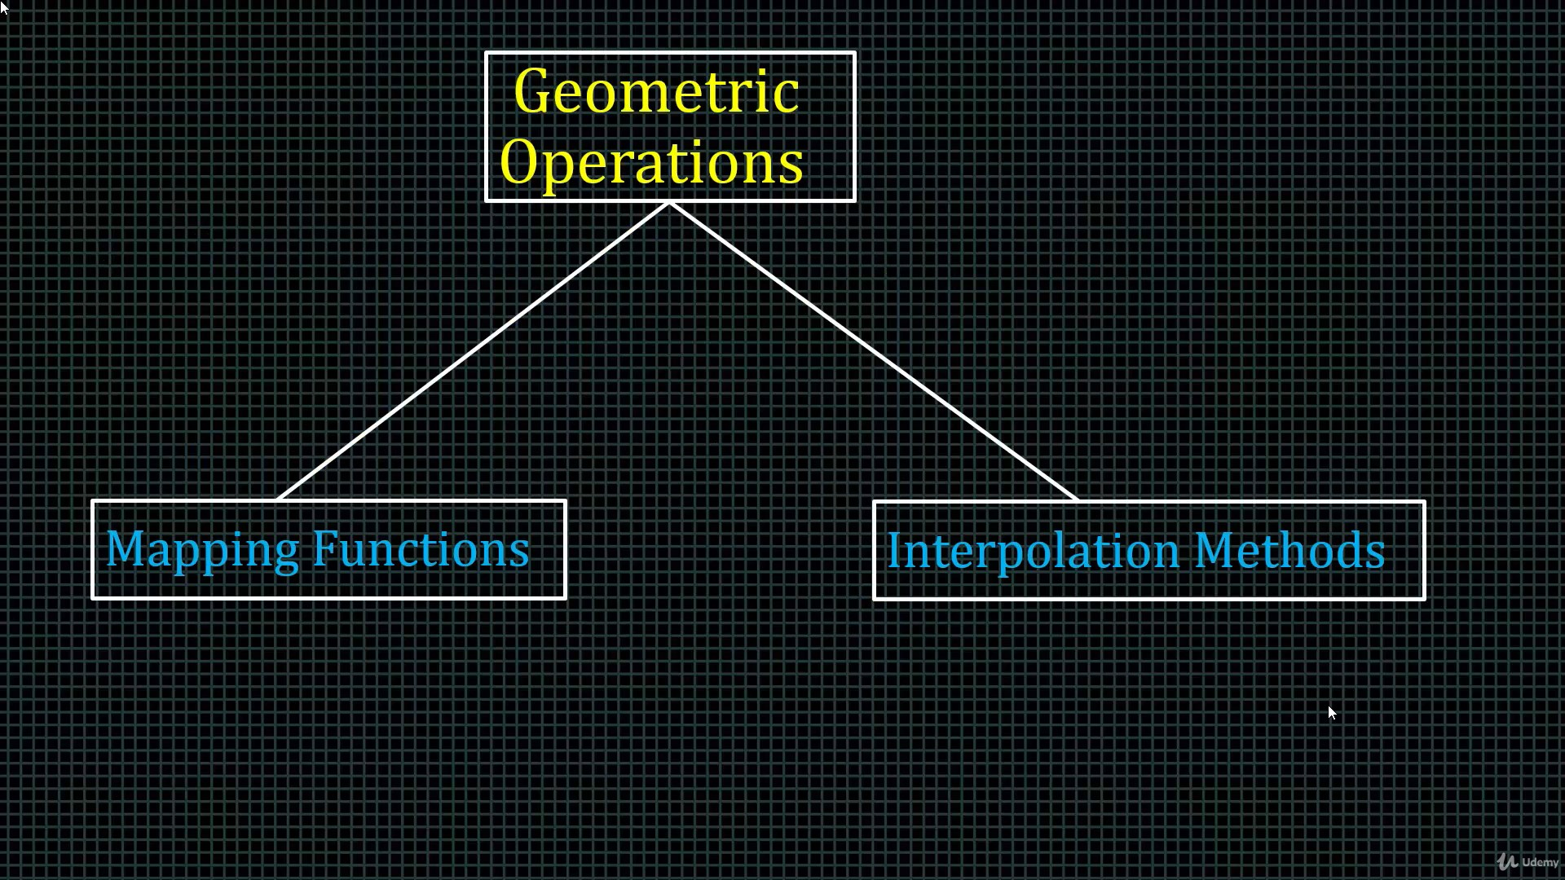
Header

Slide 44
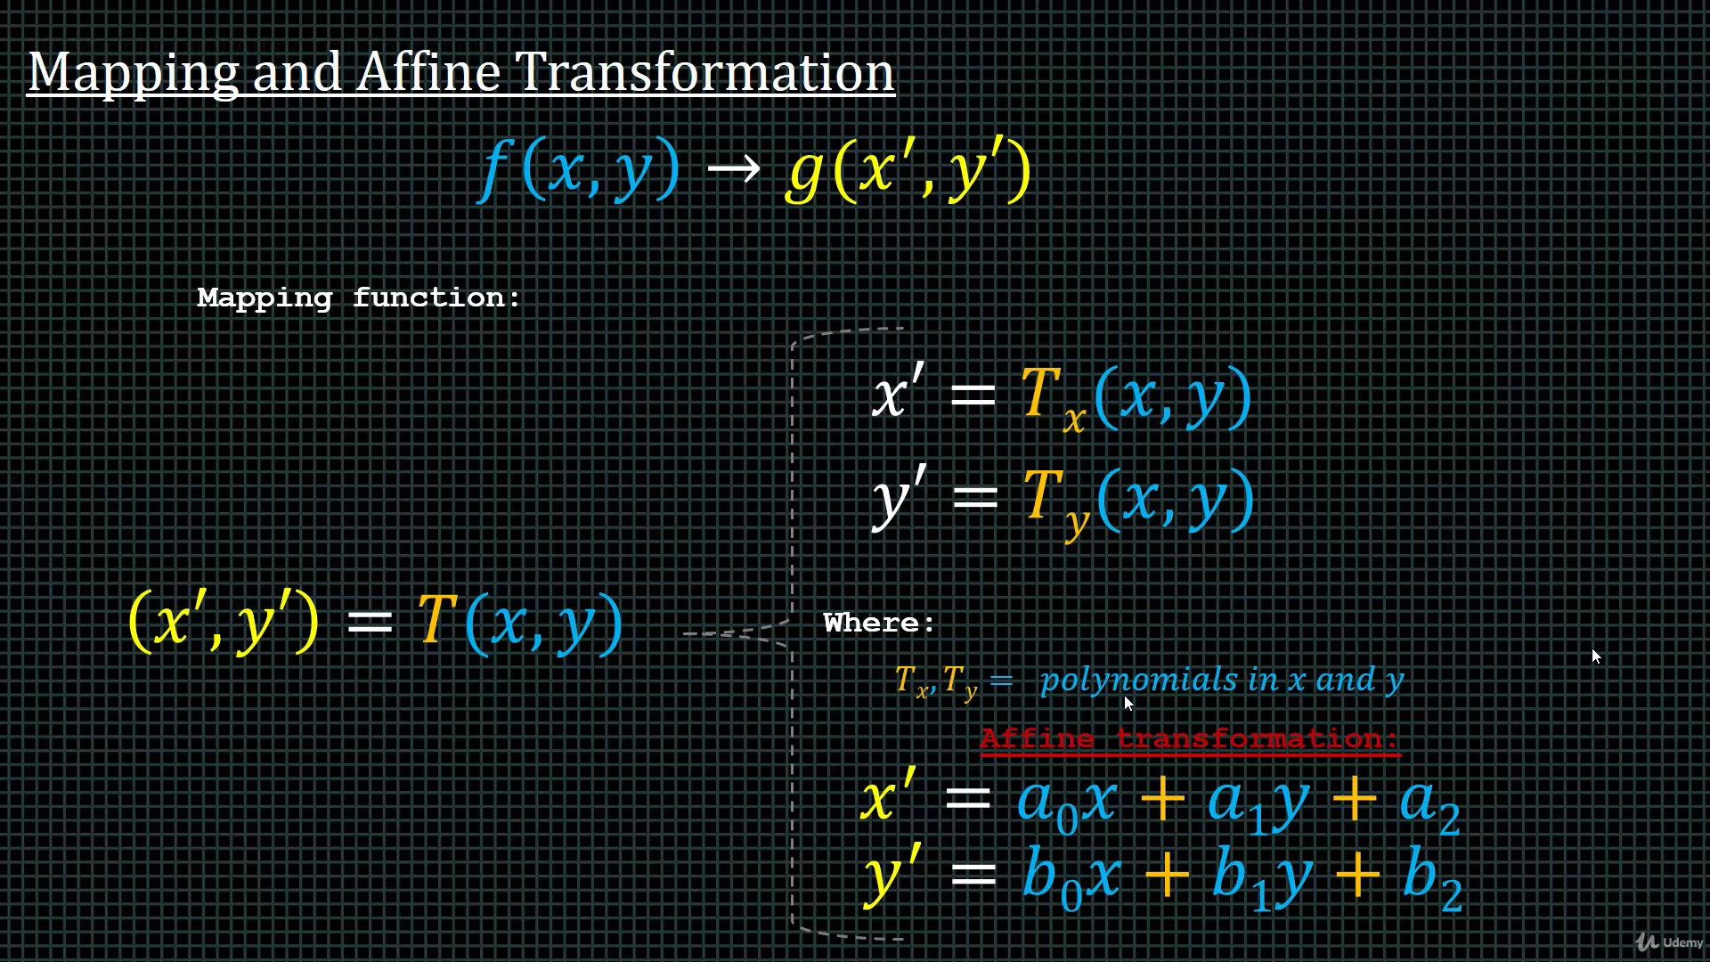
Header

Slide 45
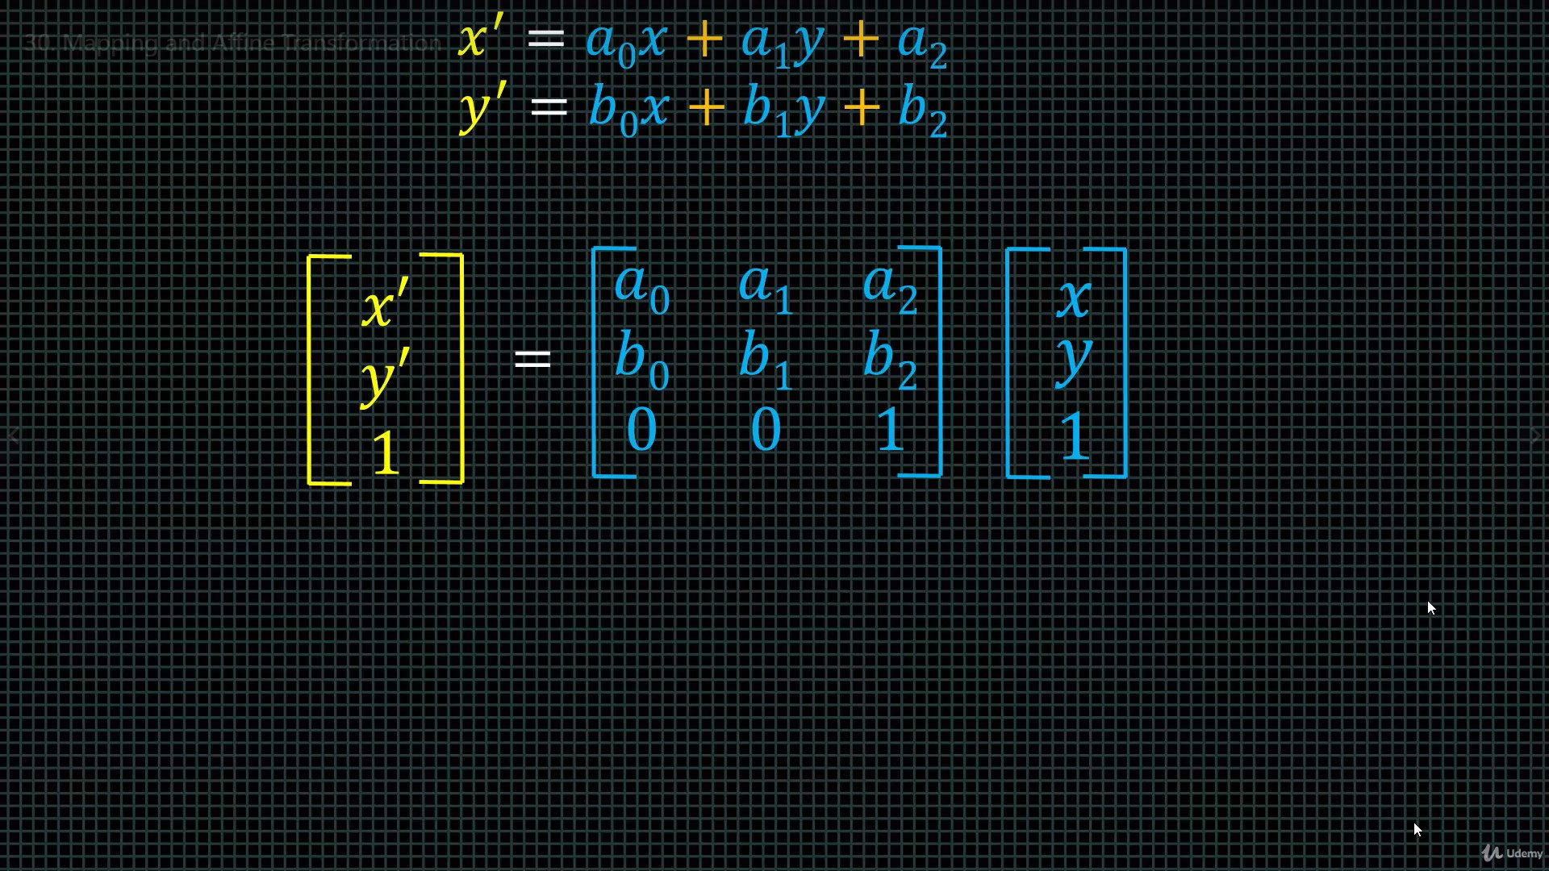
Header

Slide 46
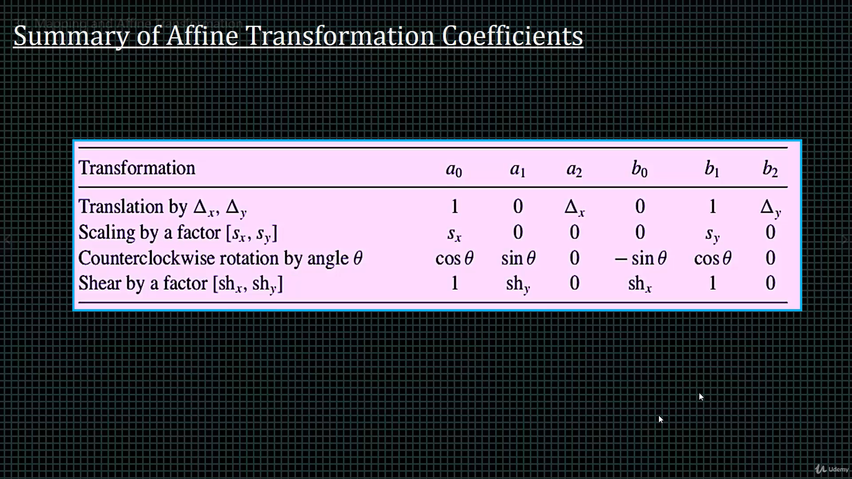
Header

Slide 47
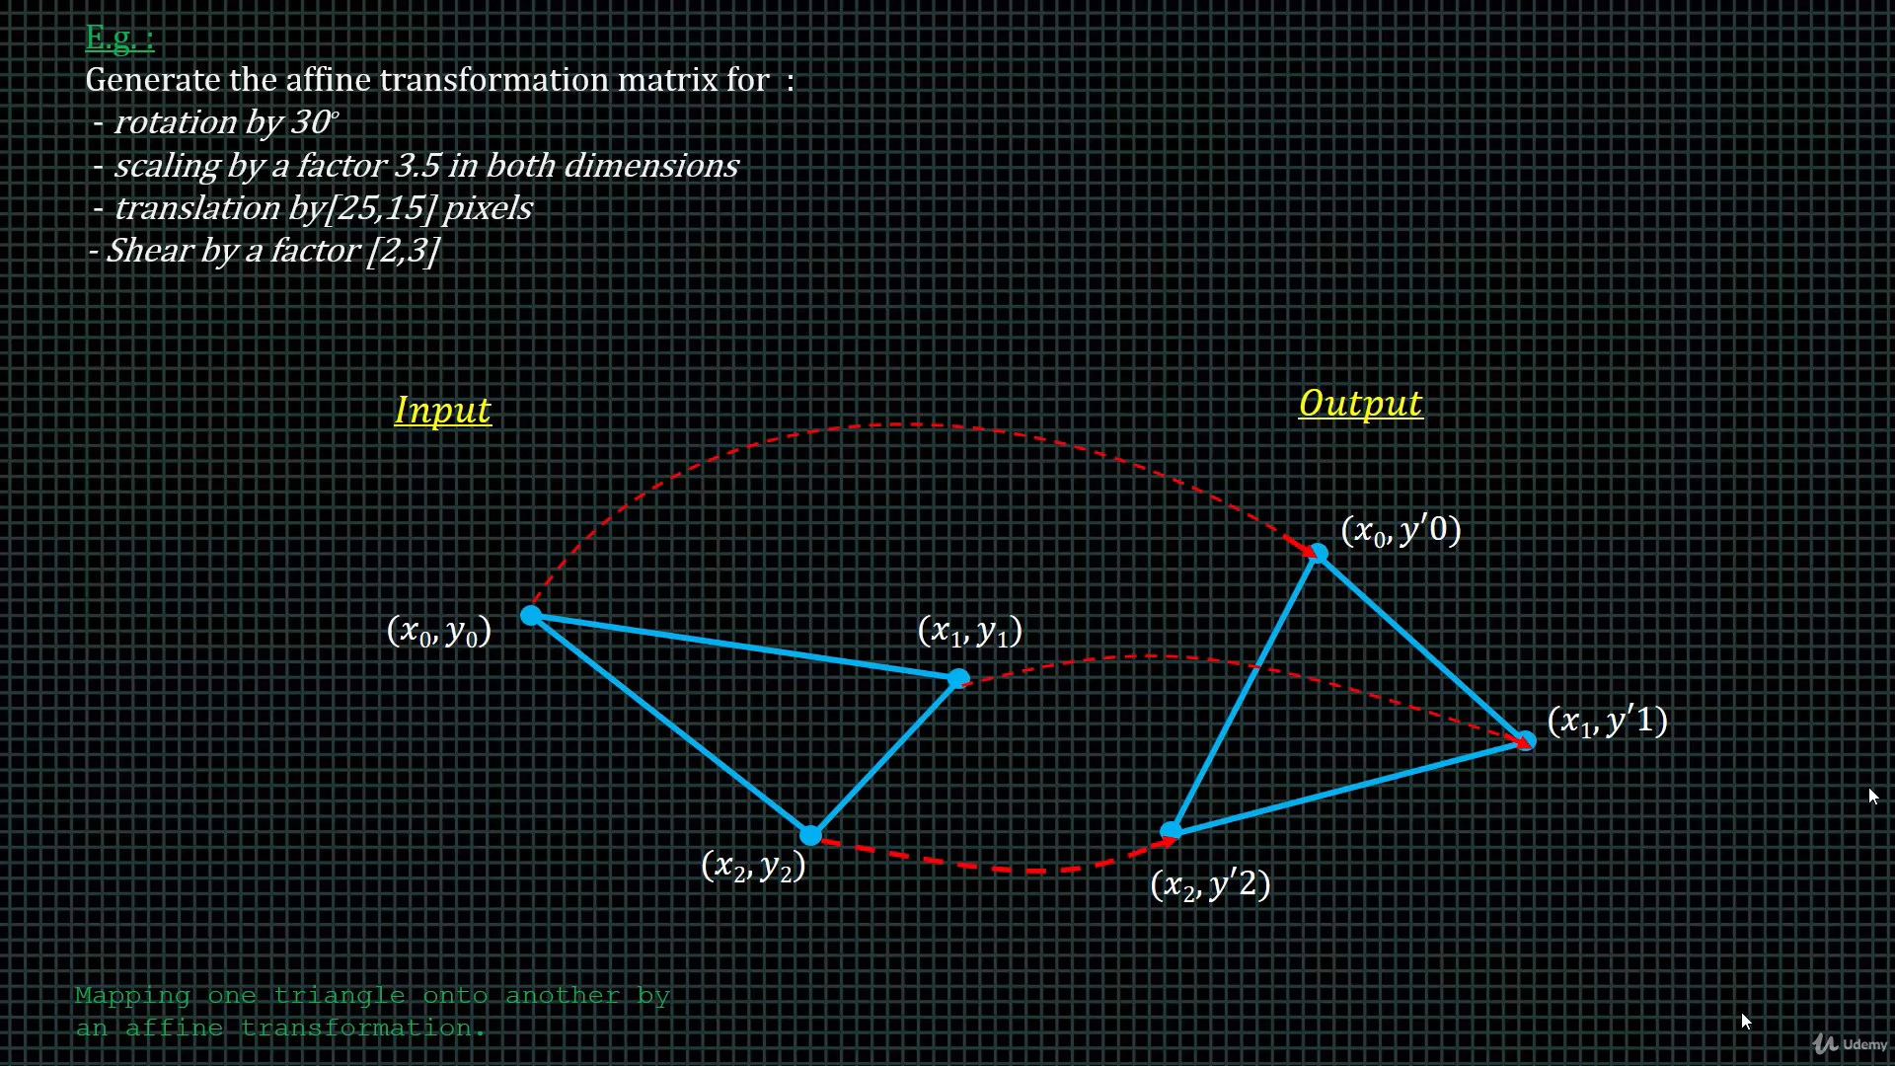
Header

Slide 48
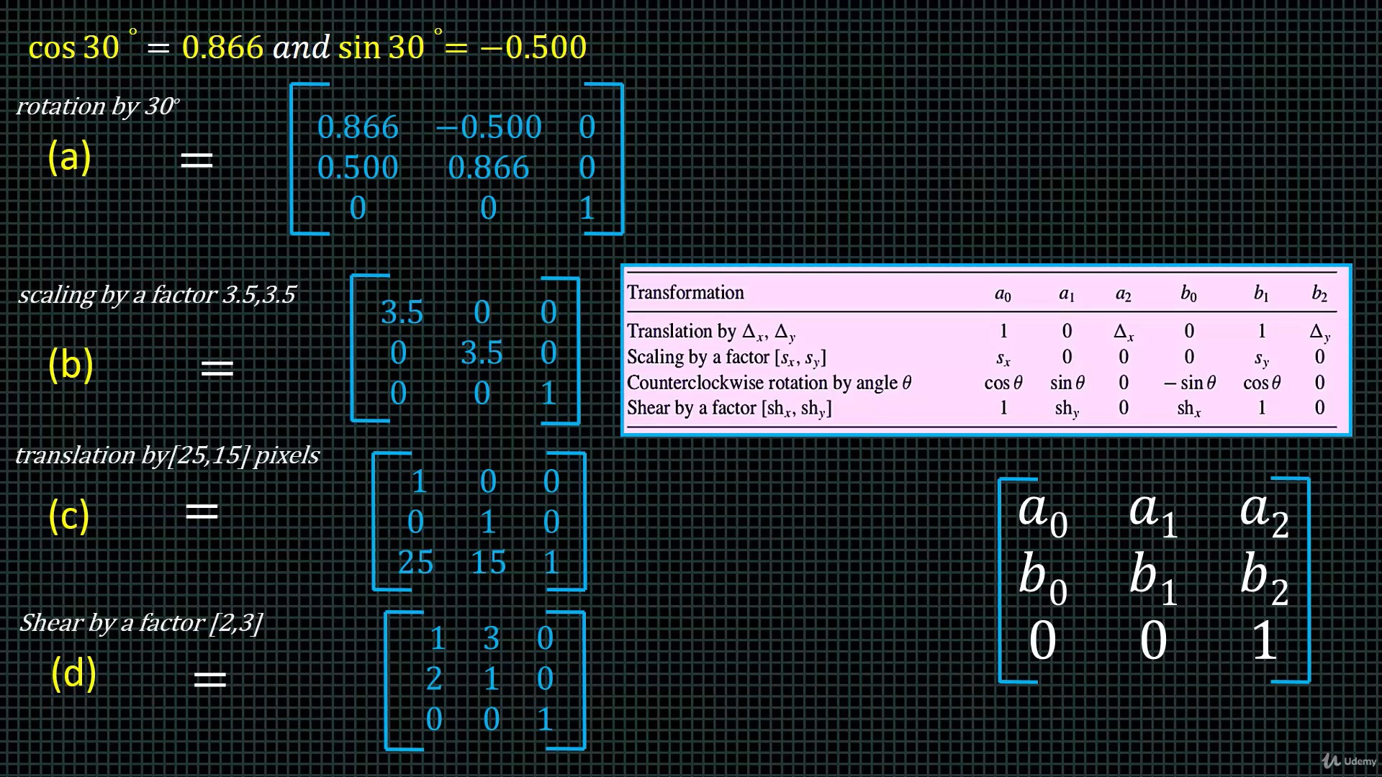
Header

Slide 49
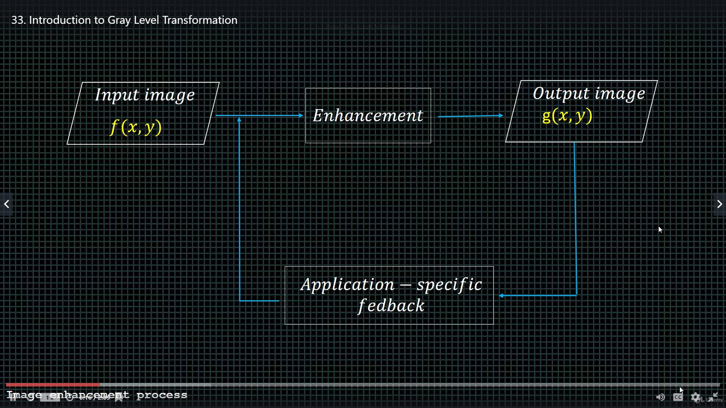
Header

Slide 50
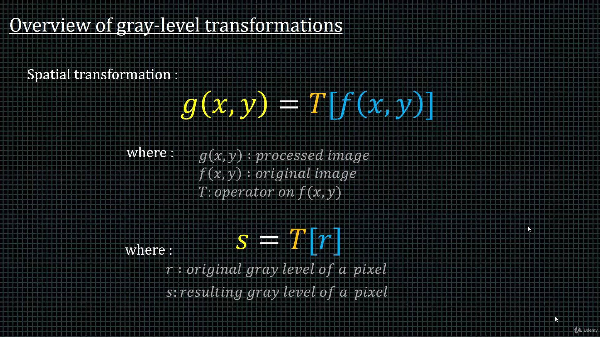
Header

Slide 51
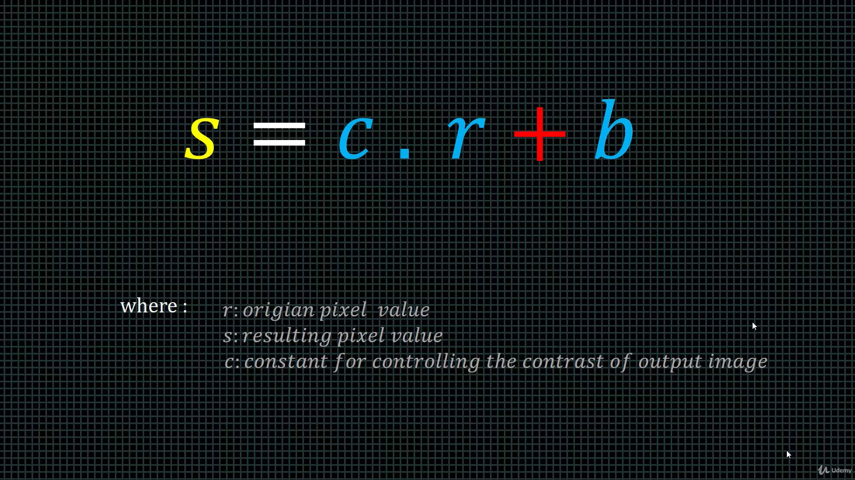
Header

Slide 52
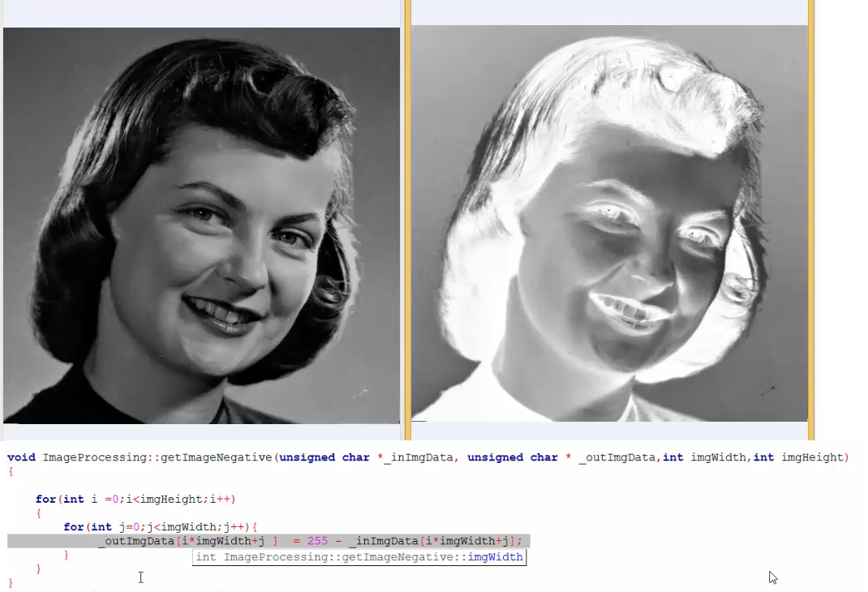
Header

Slide 53
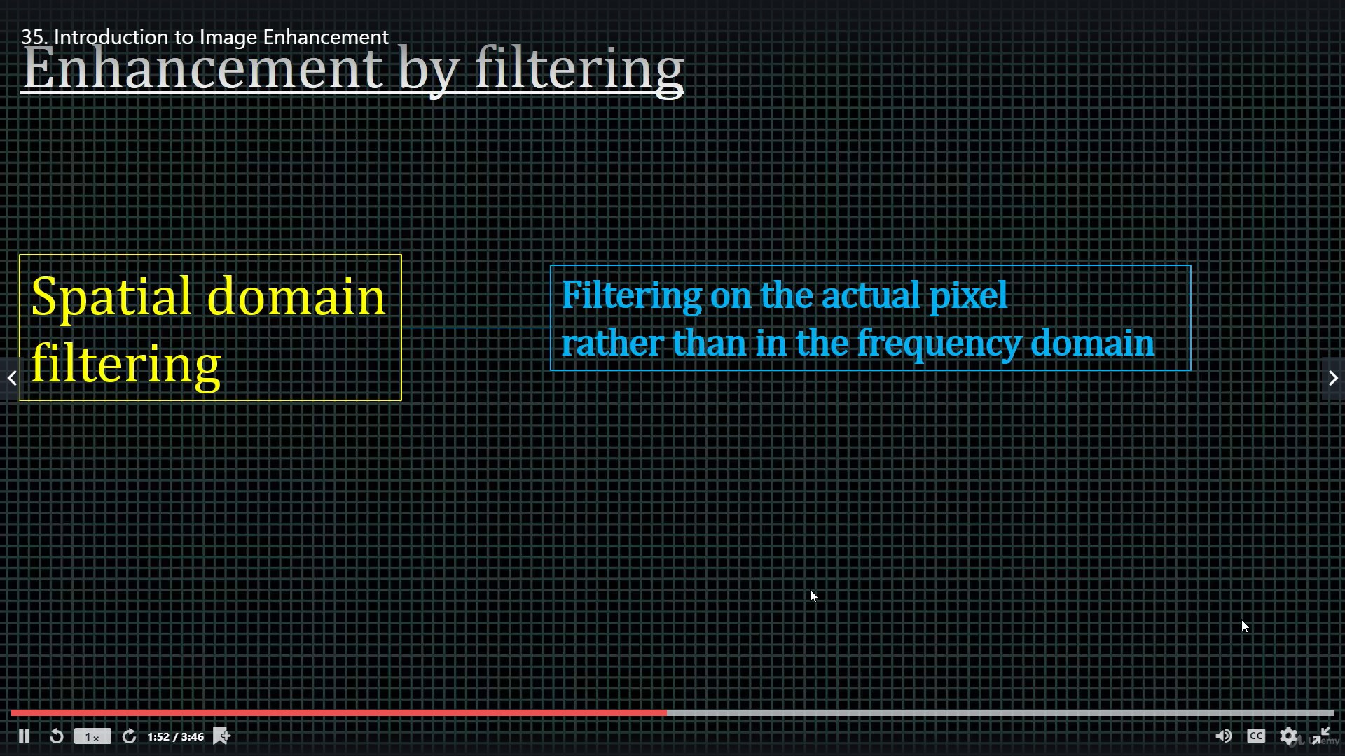
Header

Slide 54
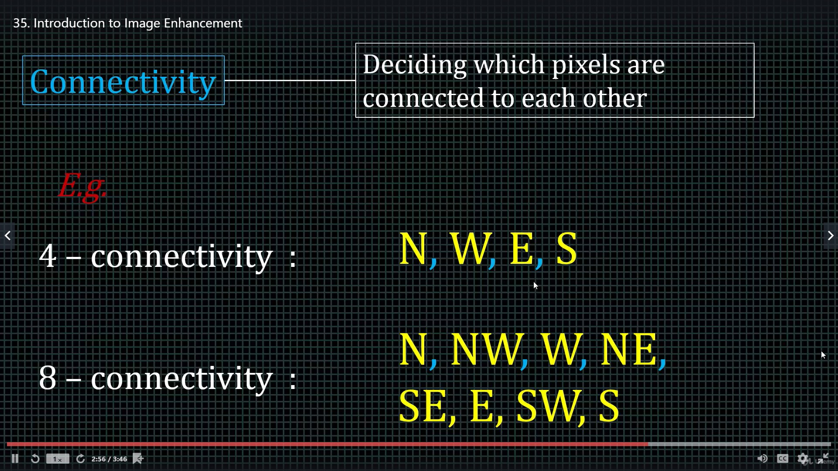
Header

Slide 55
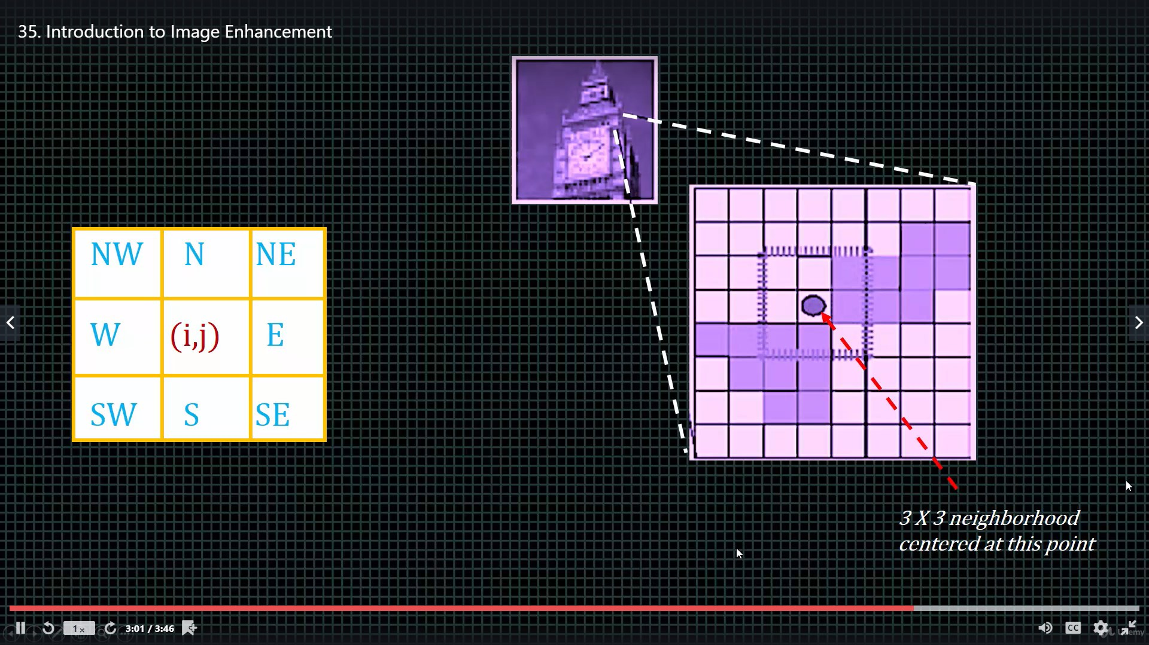
Header

Slide 56
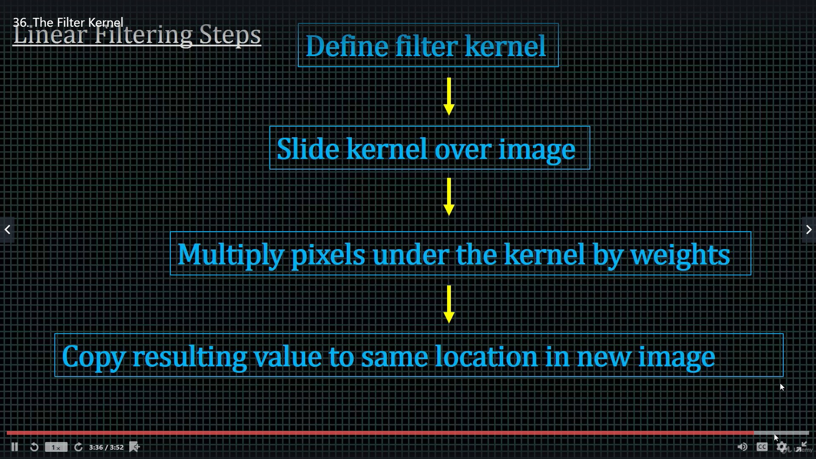
Header

Slide 57

Header

Slide 58

Header

Slide 59

Header

Slide 60

Header

Slide 61

Header

Slide 62

Header

Slide 63

Header

Slide 64

Header

Slide 65

Header

Slide 66

Header

Slide 67

Header

Slide 68
Header

